Slide 1



Machine Learning Techniques for High-throughout Analysis of TR-PES Measurements
Convolutional Neural Networks employed to fit XPS spectra
Romaric Sallustre, Arthur Julien, Jean-Baptiste Puel, Philip Schulz
04/07/2024

Slide 2
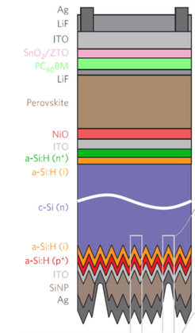
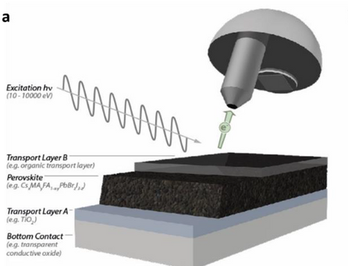
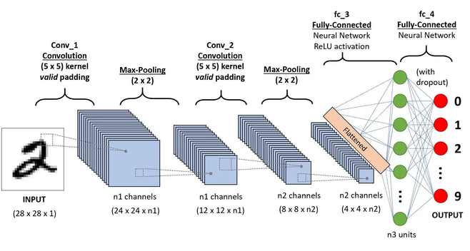
INTRODUCTION
TR-PES is a powerful technique for studying ultrafast electronic dynamics in perovskite solar cells, providing crucial insights into their electronic properties and chemical states.
The vast amount of complex, multi-dimensional data generated by TR-PES presents a significant challenge for conventional analysis methods, necessitating more efficient techniques.
We employ Convolutional Neural Networks (CNNs) to analyze TR-PES data, enabling rapid quantification of chemical states and electronic properties while potentially uncovering subtle patterns overlooked by traditional methods.
P. Schulz et al. Chem. Rev. 2019. S. Béchu et al. Adv. Energy Mater. 2020. M. Ralaiarisoa et al. Small Methods 2023. V. Milotti et al. Small Methods 2023.

Slide 3

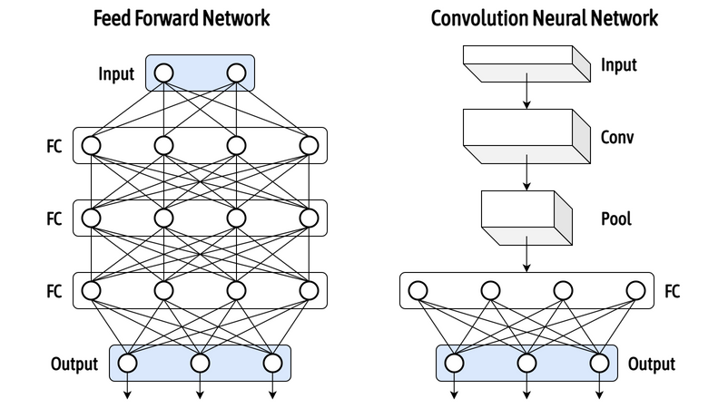
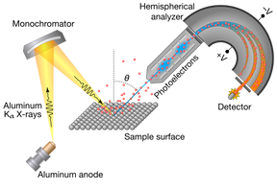
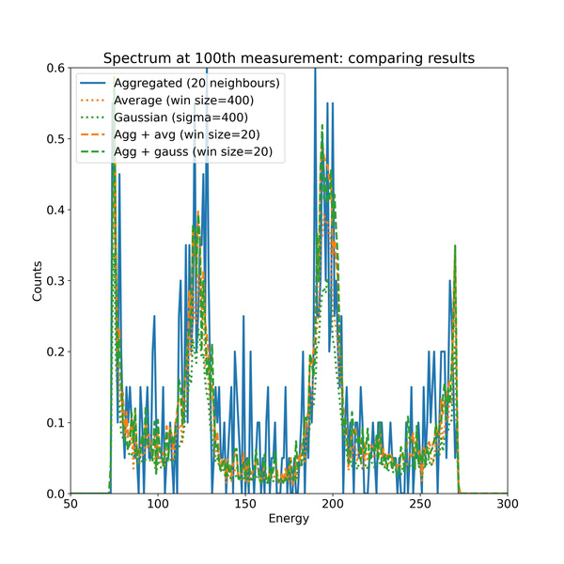
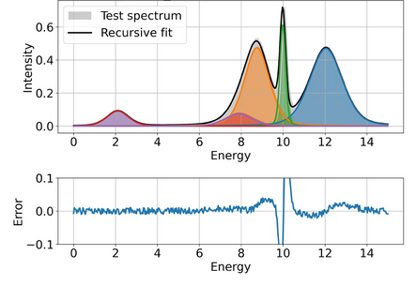
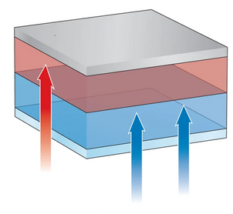
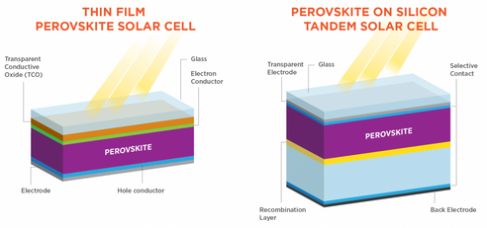

APPROACH
Tandem
Solar Cells
Thin Film Absorber Layer
Time-resolved Photoelectron
Spectroscopy
High Throughput Data Treatment
AI Guided Mechanisms
Analyzed Waveform
CELL 1
CELL 2
High Energy Sunlight
Low Energy Sunlight
Hybrid Organic Inorganic Lead Halide Perovskite
Assess Chemical and Optoelectronic properties at the surface
Desired:
Efficient and Reliable Spectrum Decompositions and Fits
P. Schulz et al. Chem. Rev. 2019. S. Béchu et al. Adv. Energy Mater. 2020. M. Ralaiarisoa et al. Small Methods 2023. V. Milotti et al. Small Methods 2023.

Slide 4
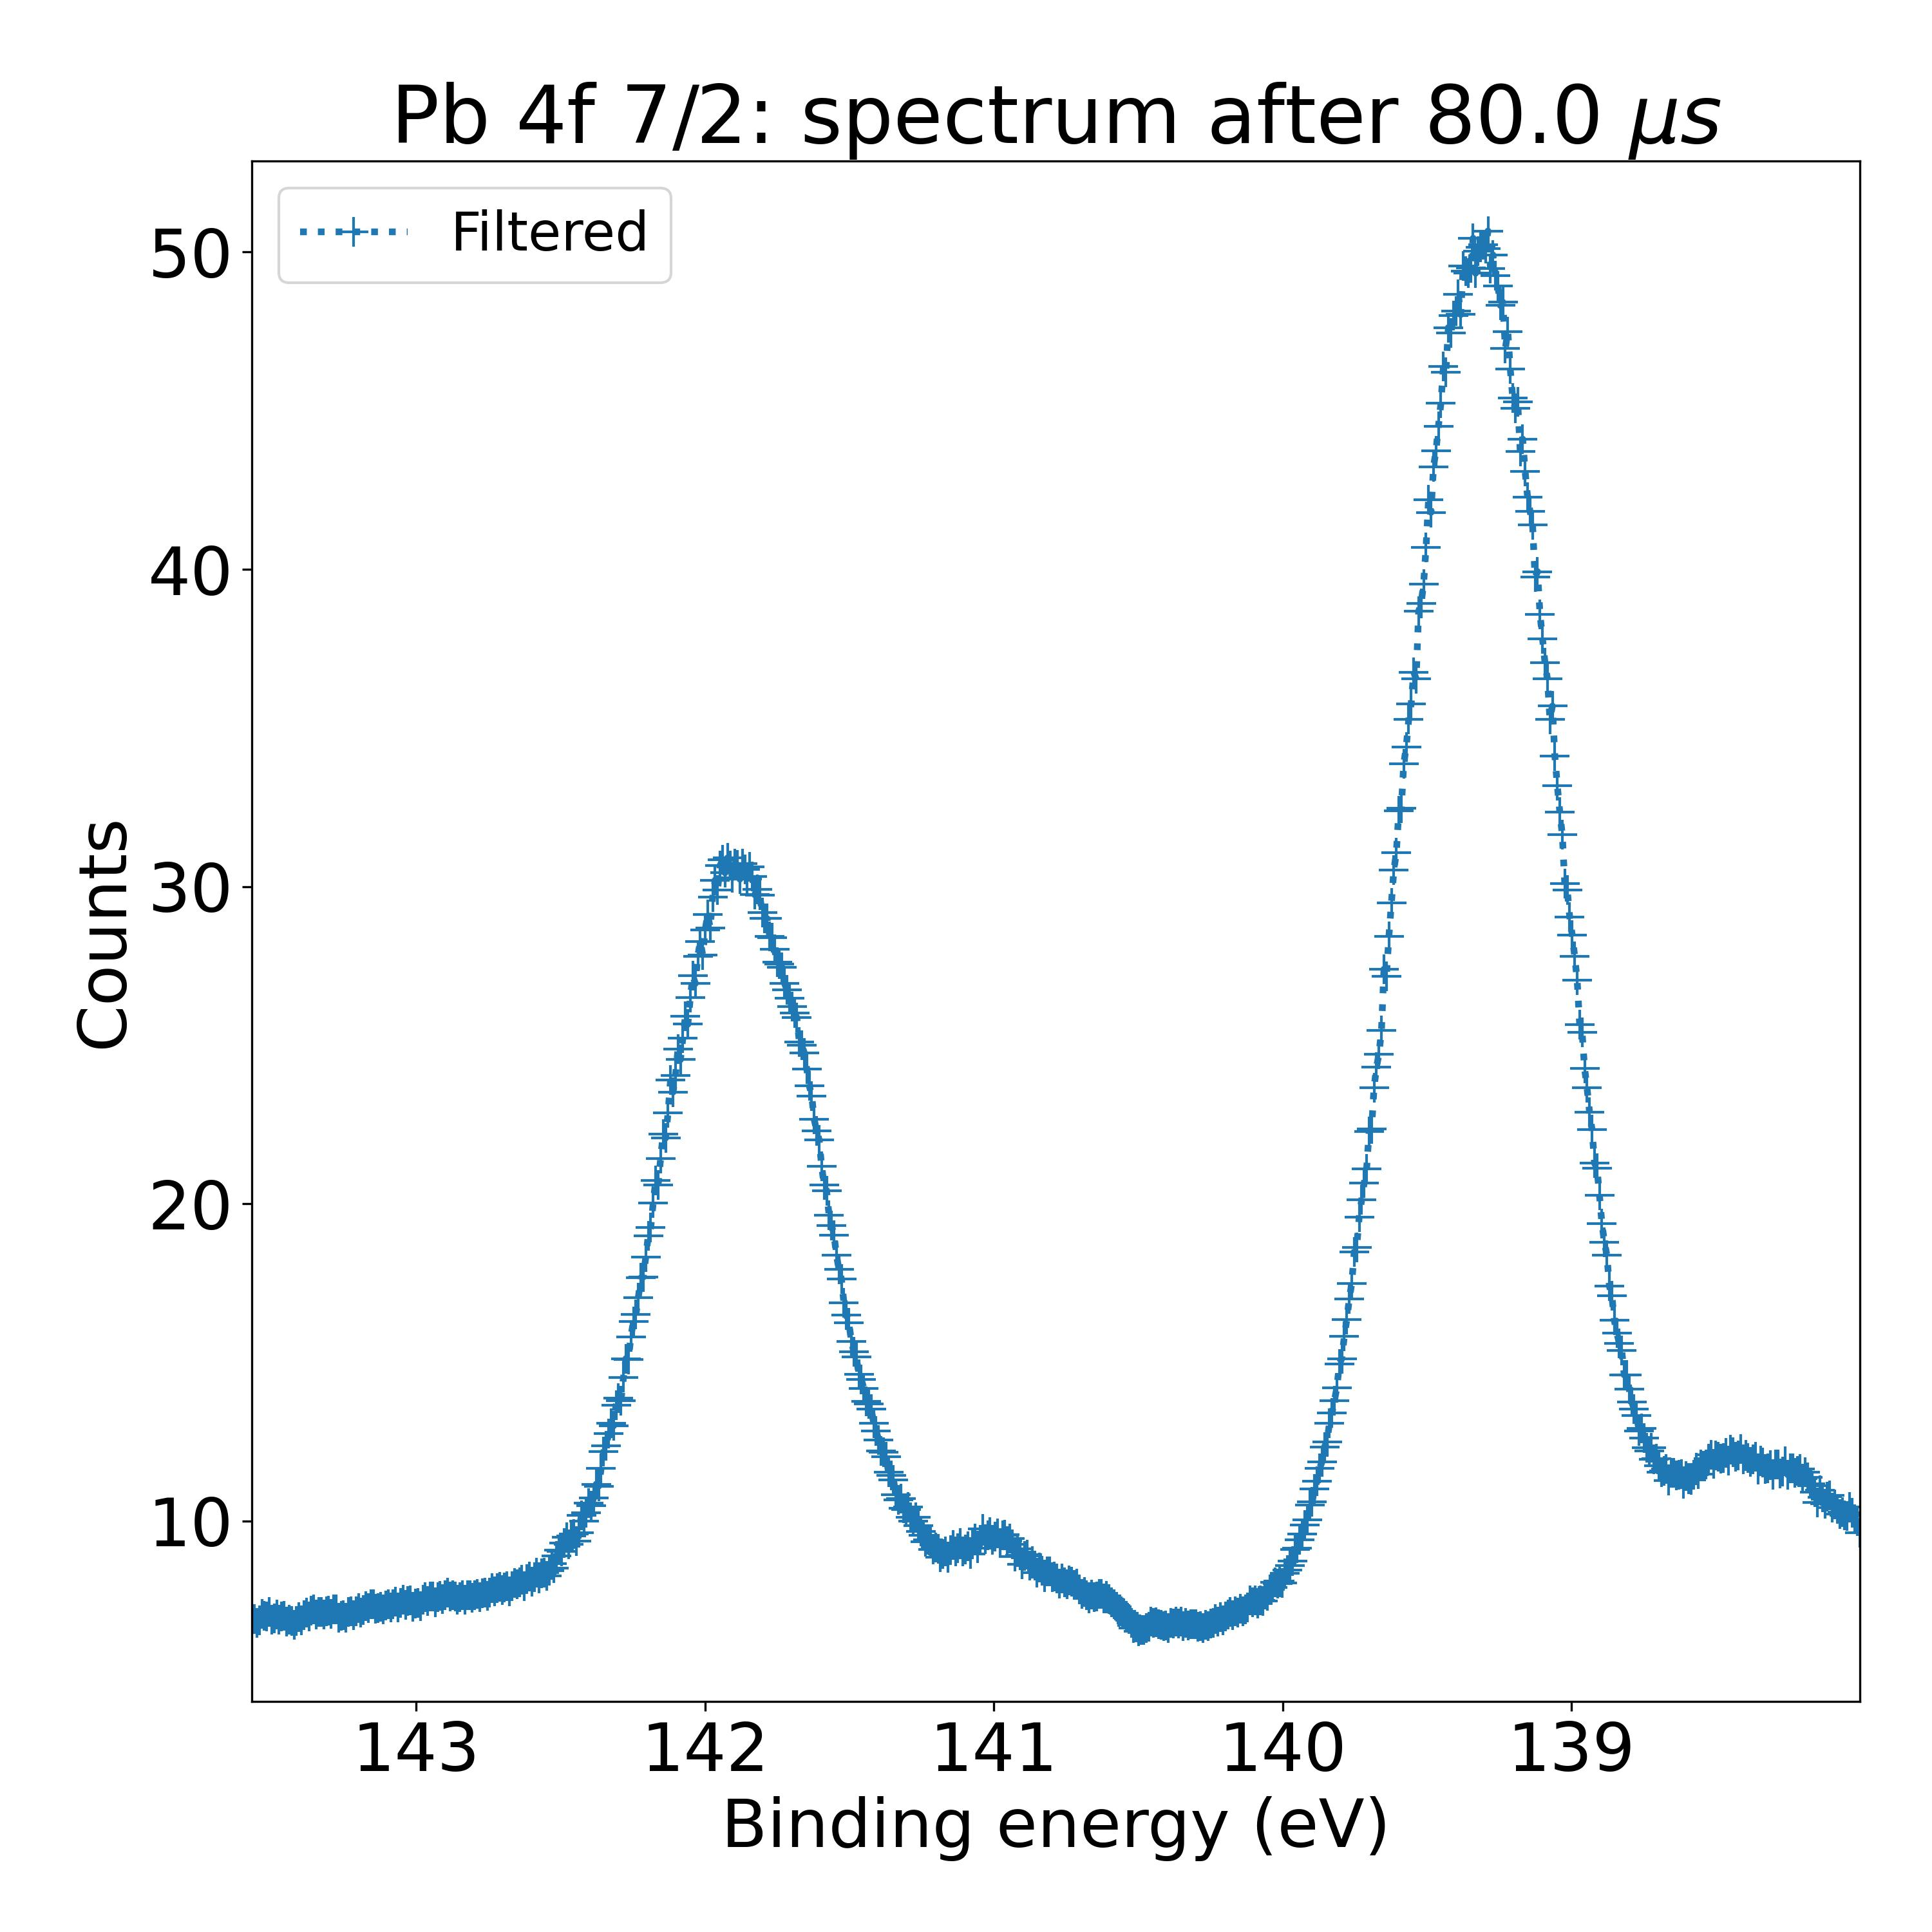
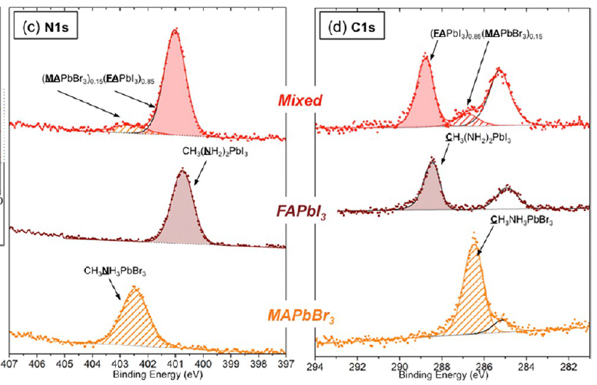
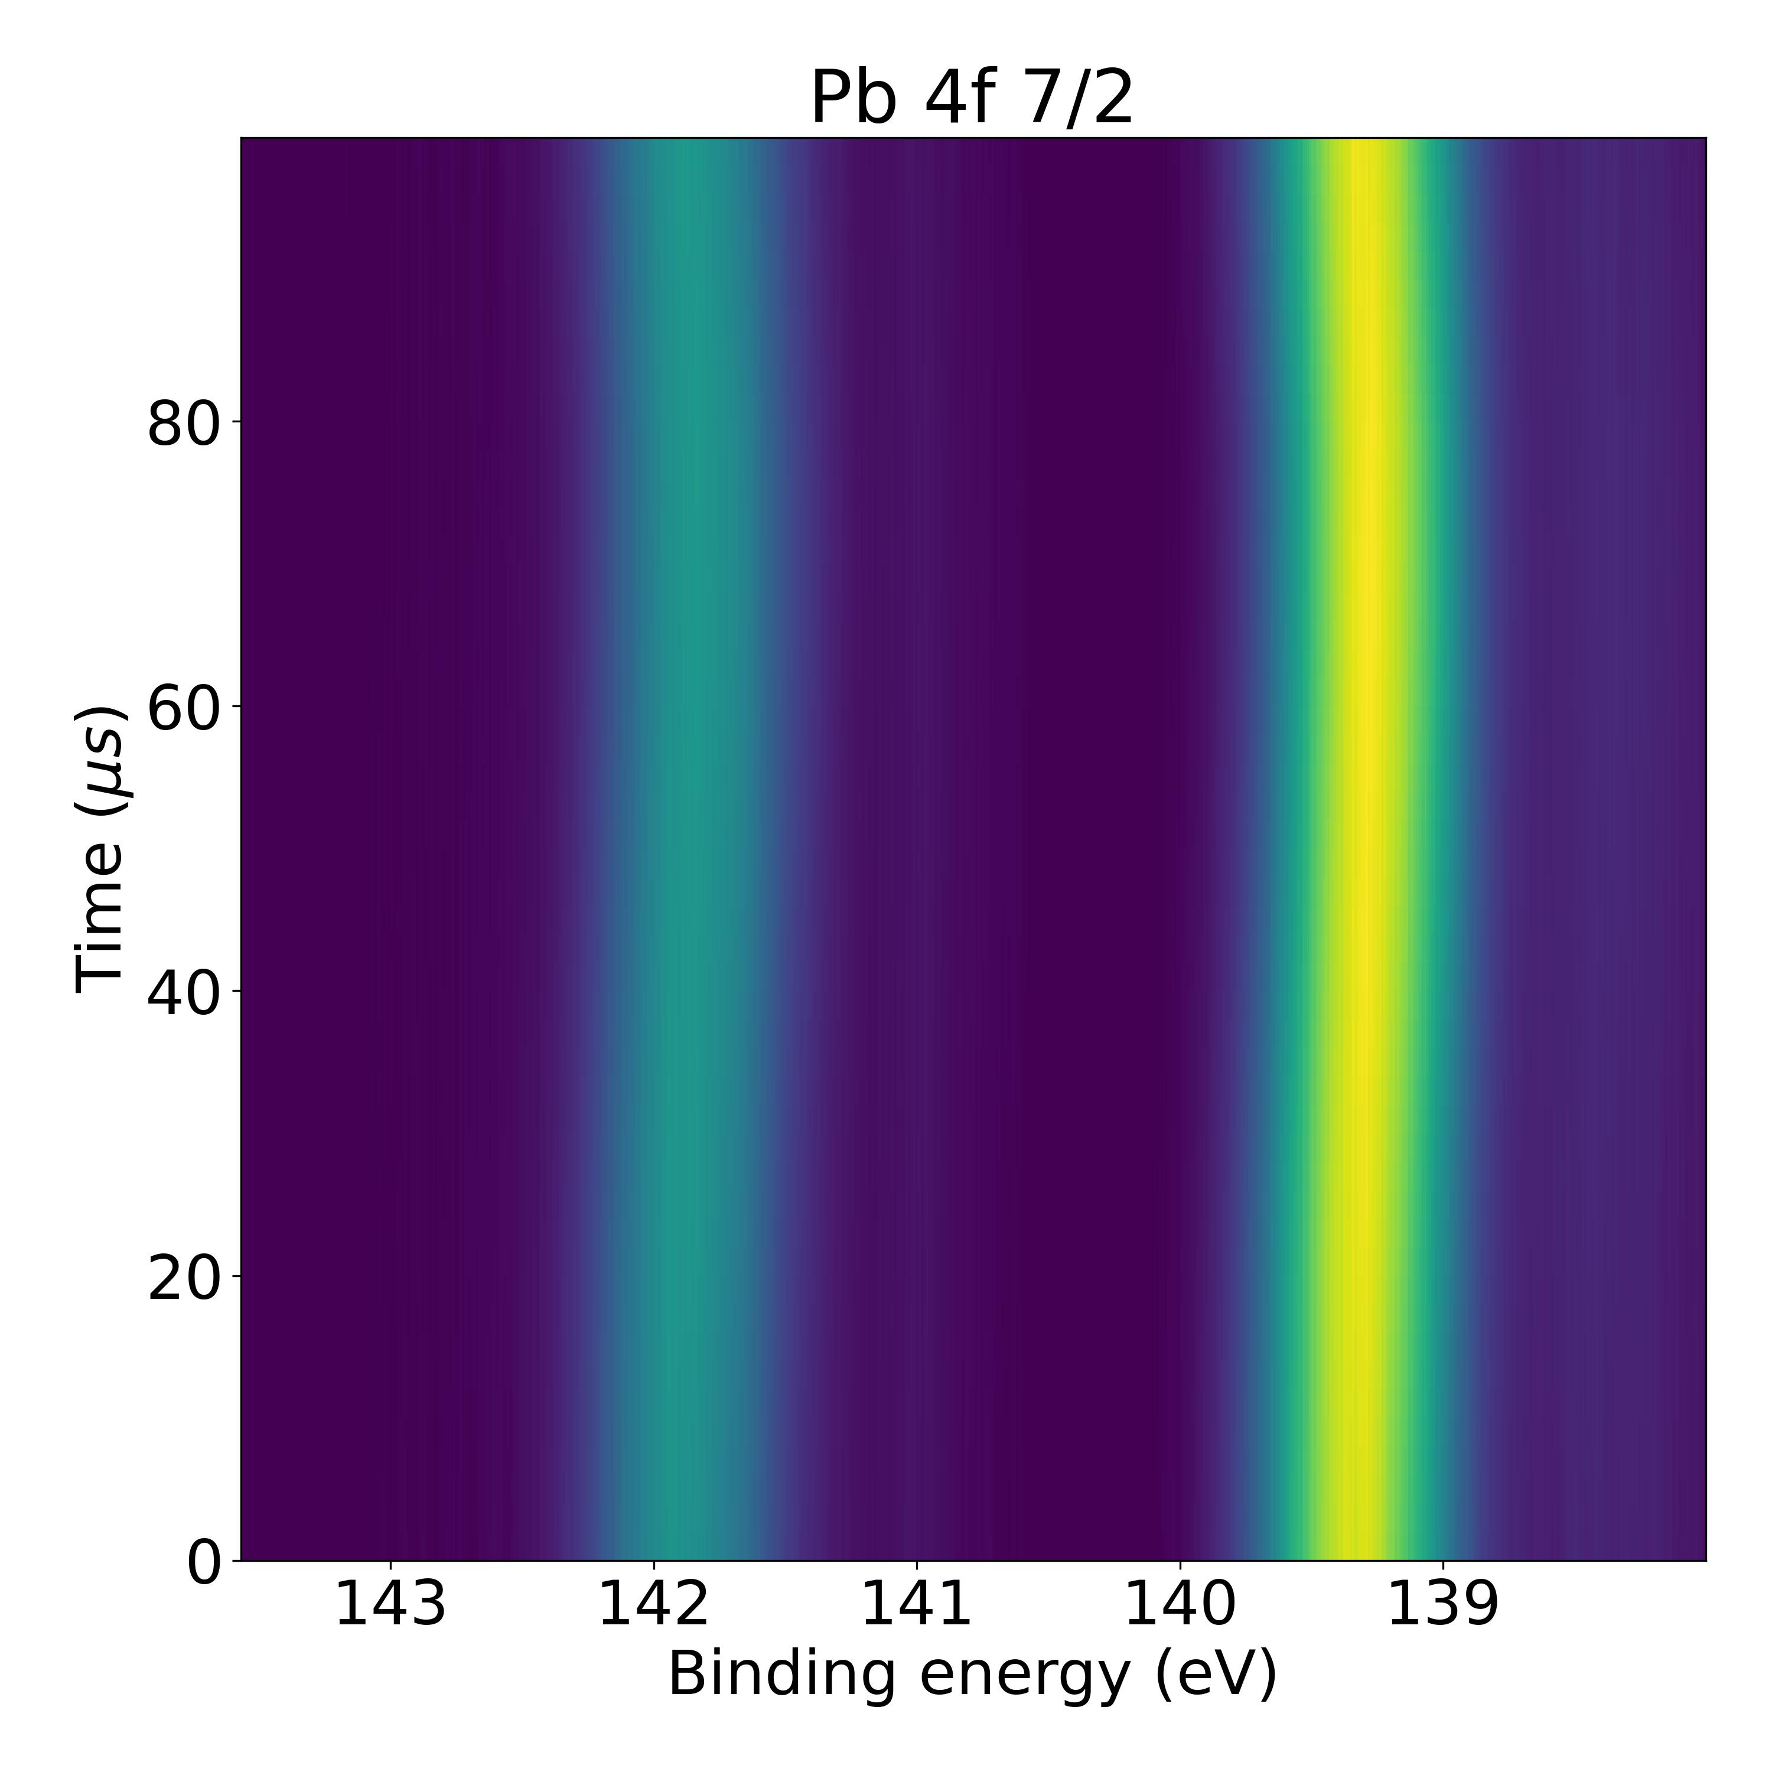
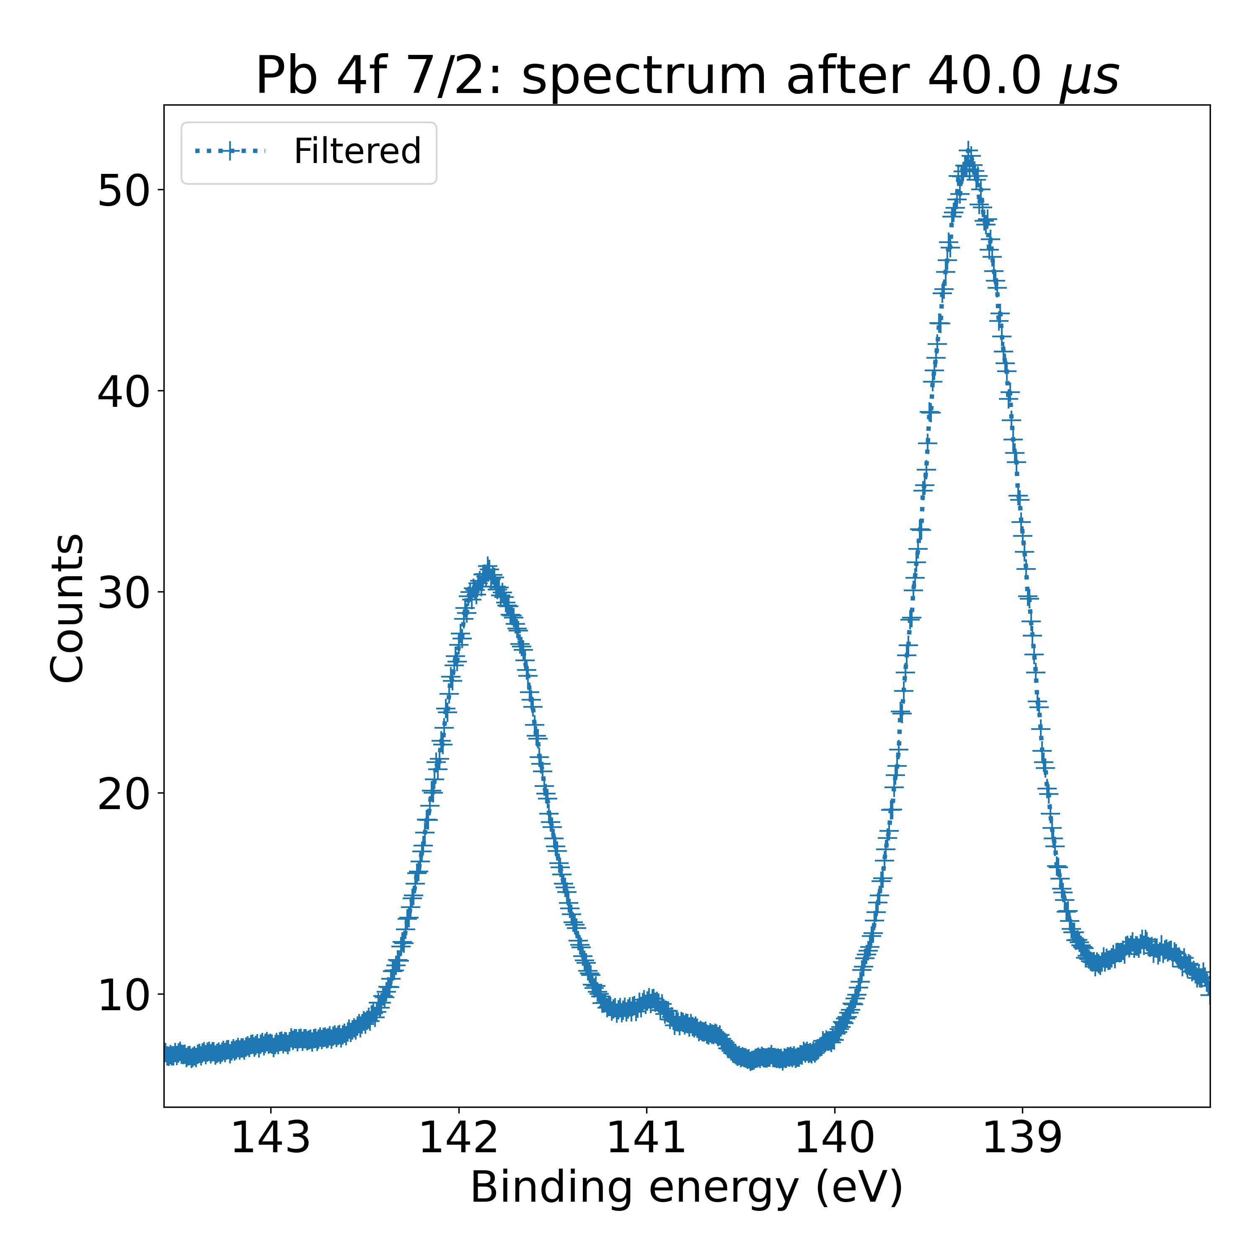
AI Fitting Necessity
Fitting procedure must allow to distinguish peak contributions in XPS spectra
TR-XPS measurements: high throughput analysis methods are necessary
Two different contributions in mixed composition
Two different chemical environments for nitrogen atoms
1000 spectra to analyze
Jacobsson, T. J., Correa-Baena, J. P., Halvani Anaraki, E., Philippe, B., Stranks, S. D., Bouduban, M. E. F., Tress, W., Schenk, K., Teuscher, J., Moser, J. E., Rensmo, H., & Hagfeldt, A. (2016). Unreacted PbI2 as a Double-Edged Sword for Enhancing the Performance of Perovskite Solar Cells. Journal of the American Chemical Society, 138(32), 10331–10343.

Slide 5

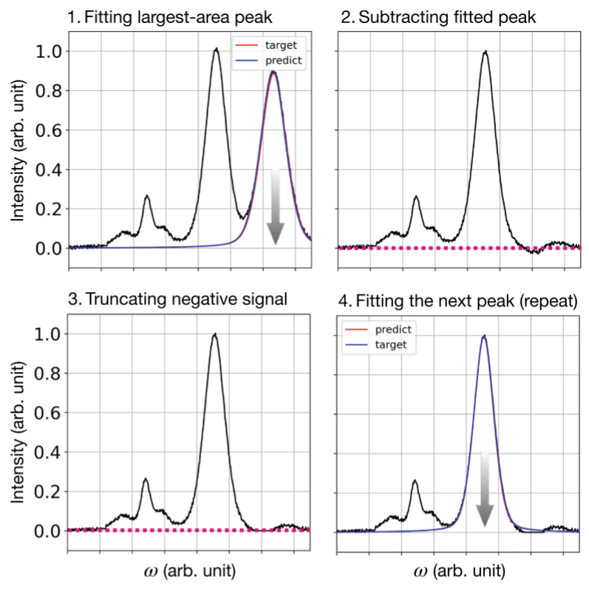
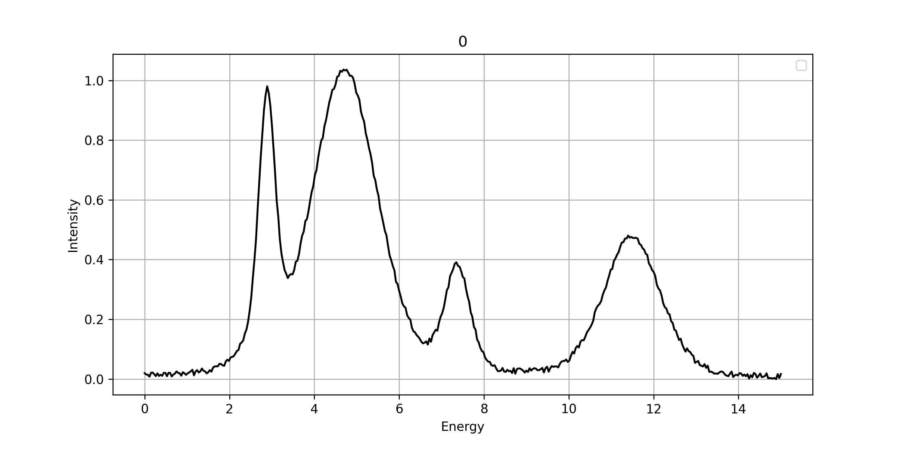
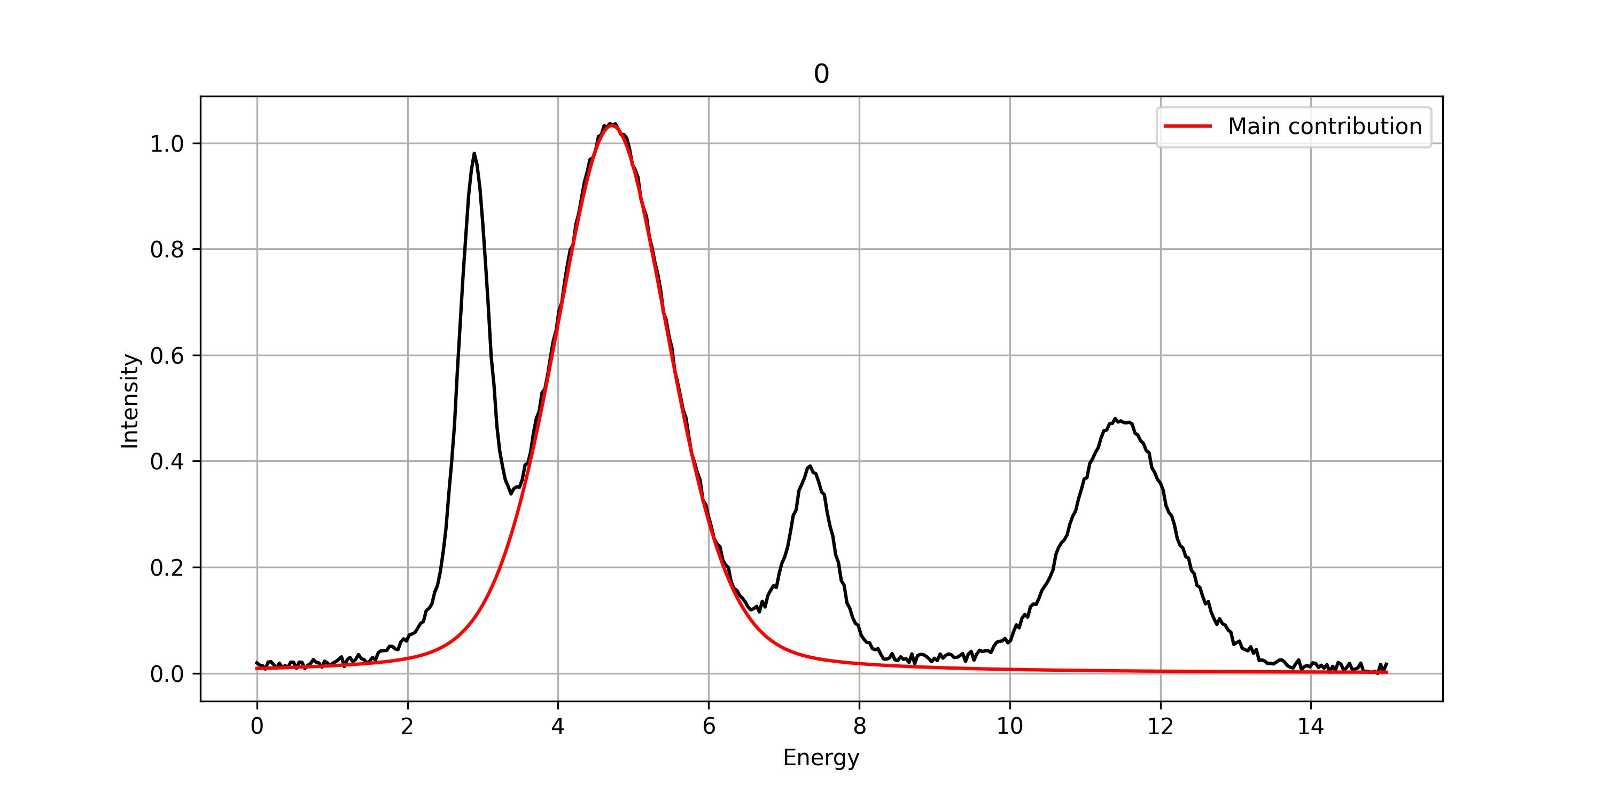
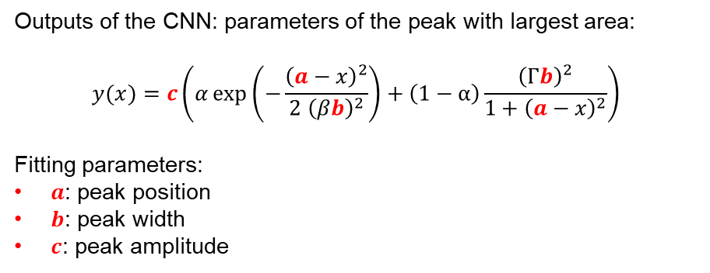
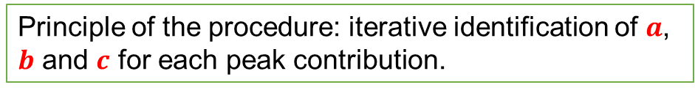
Iterative Identification of Major Peak
Convolution neural networks: serial connection of convolution products and filters
Principle of the procedure: iterative identification of $a$, $b$ and $c$ for each peak contribution.
Outputs of the CNN: parameters of the peak with largest area:
$$y(x)=c\left(α\exp\left(−\frac{{\left(a−x\right)}^{2}}{2{ \left(βb\right)}^{2}}\right)+\left(1−α\right)\frac{{\left(Γb\right)}^{2}}{1+{\left(a−x\right)}^{2}}\right)$$
Fitting parameters:
$a$: peak position
$b$: peak width
$c$: peak amplitude
Park, S. H., Park, H., Lee, H., & Kim, H. S. (2021). Iterative peak-fitting of frequency-domain data via deep convolution neural networks. Journal of the Korean Physical Society, 79(12), 1199–1208.

Slide 6
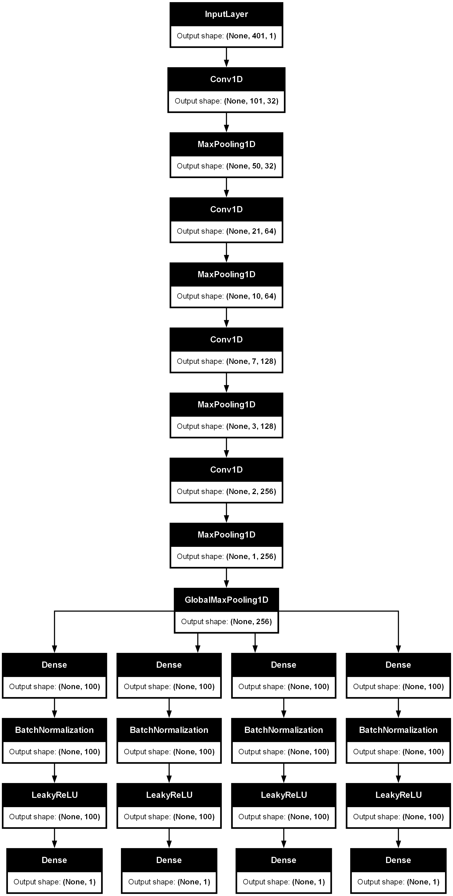
Convolutional Neural Networks for Peak Identification
Input: 1D vector containing one XPS spectrum
Contemporary CNNs include now significantly more layers:
Activations functions
Normalizations
Random perturbations
…
Convolution layer
Filtering layer
Outputs: four values:
Major peak position
Major peak width
Major peak amplitude
Total number of peaks
Training of CNN is necessary to adjust internal parameters and obtain desired outputs
6

Slide 7
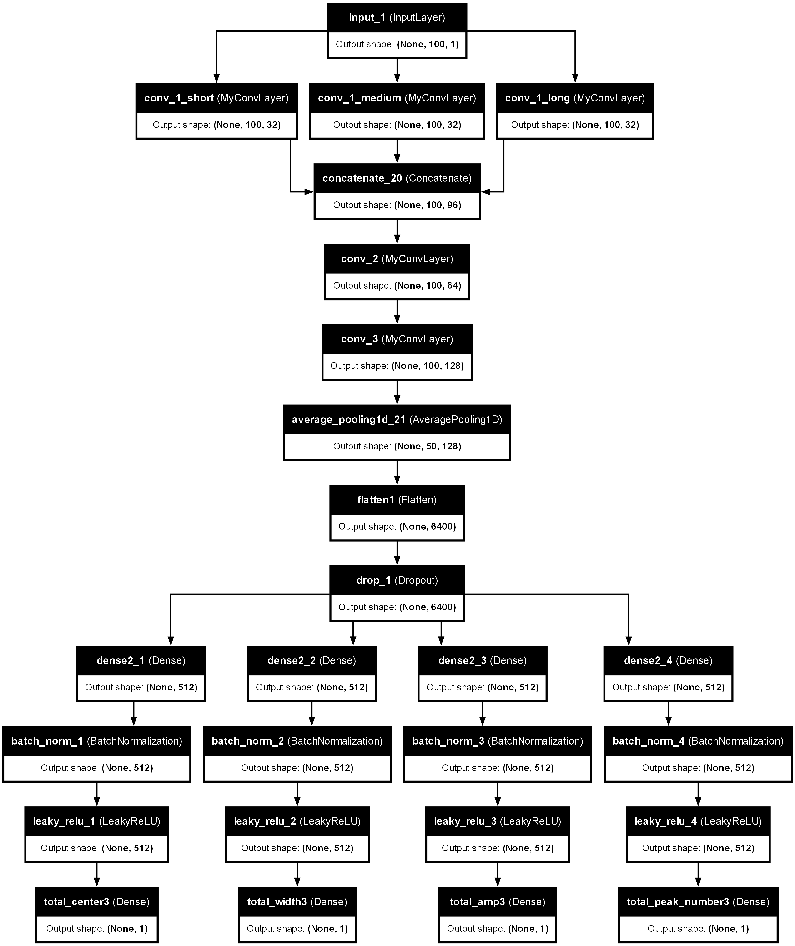
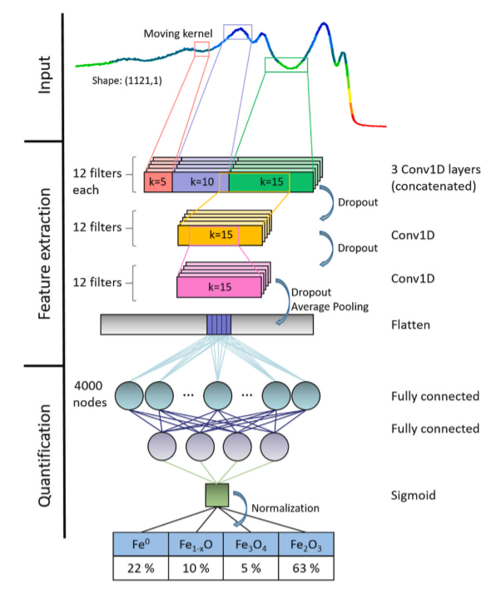
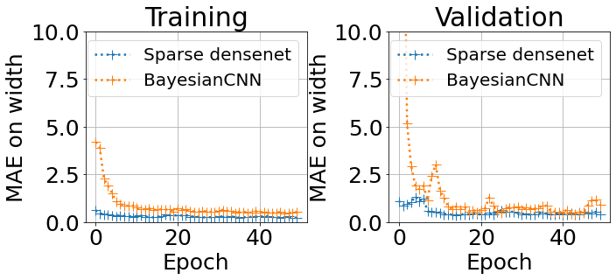
Bayesian CNN
Convolution Layer
Dense Layer
+
=
Statistical error over test database:
 | Sparse densenet | Bayesian CNN
MAE on major peak position | 0.78 | 0.94
MAE major peak width | 0.16 | 0.45
MAE major peak amplitude | 0.05 | 0.49
MAE on total number of peaks | 0.26 | 1.31
Average fit time | 2.43x10⁻² s | 1.74x10⁻² s
Pielsticker, L., Nicholls, R. L., DeBeer, S., & Greiner, M. (2023). Convolutional neural network framework for the automated analysis of transition metal X-ray photoelectron spectra. Analytica Chimica Acta, 1271.

Slide 8
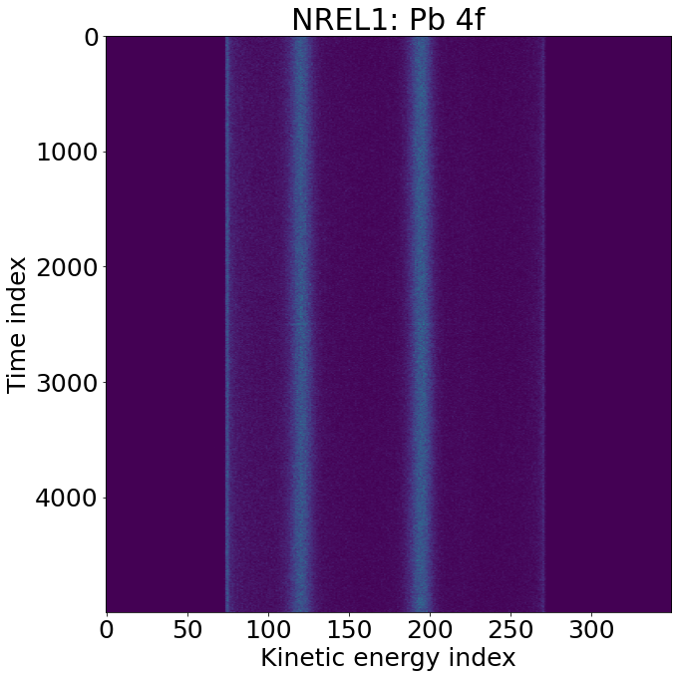
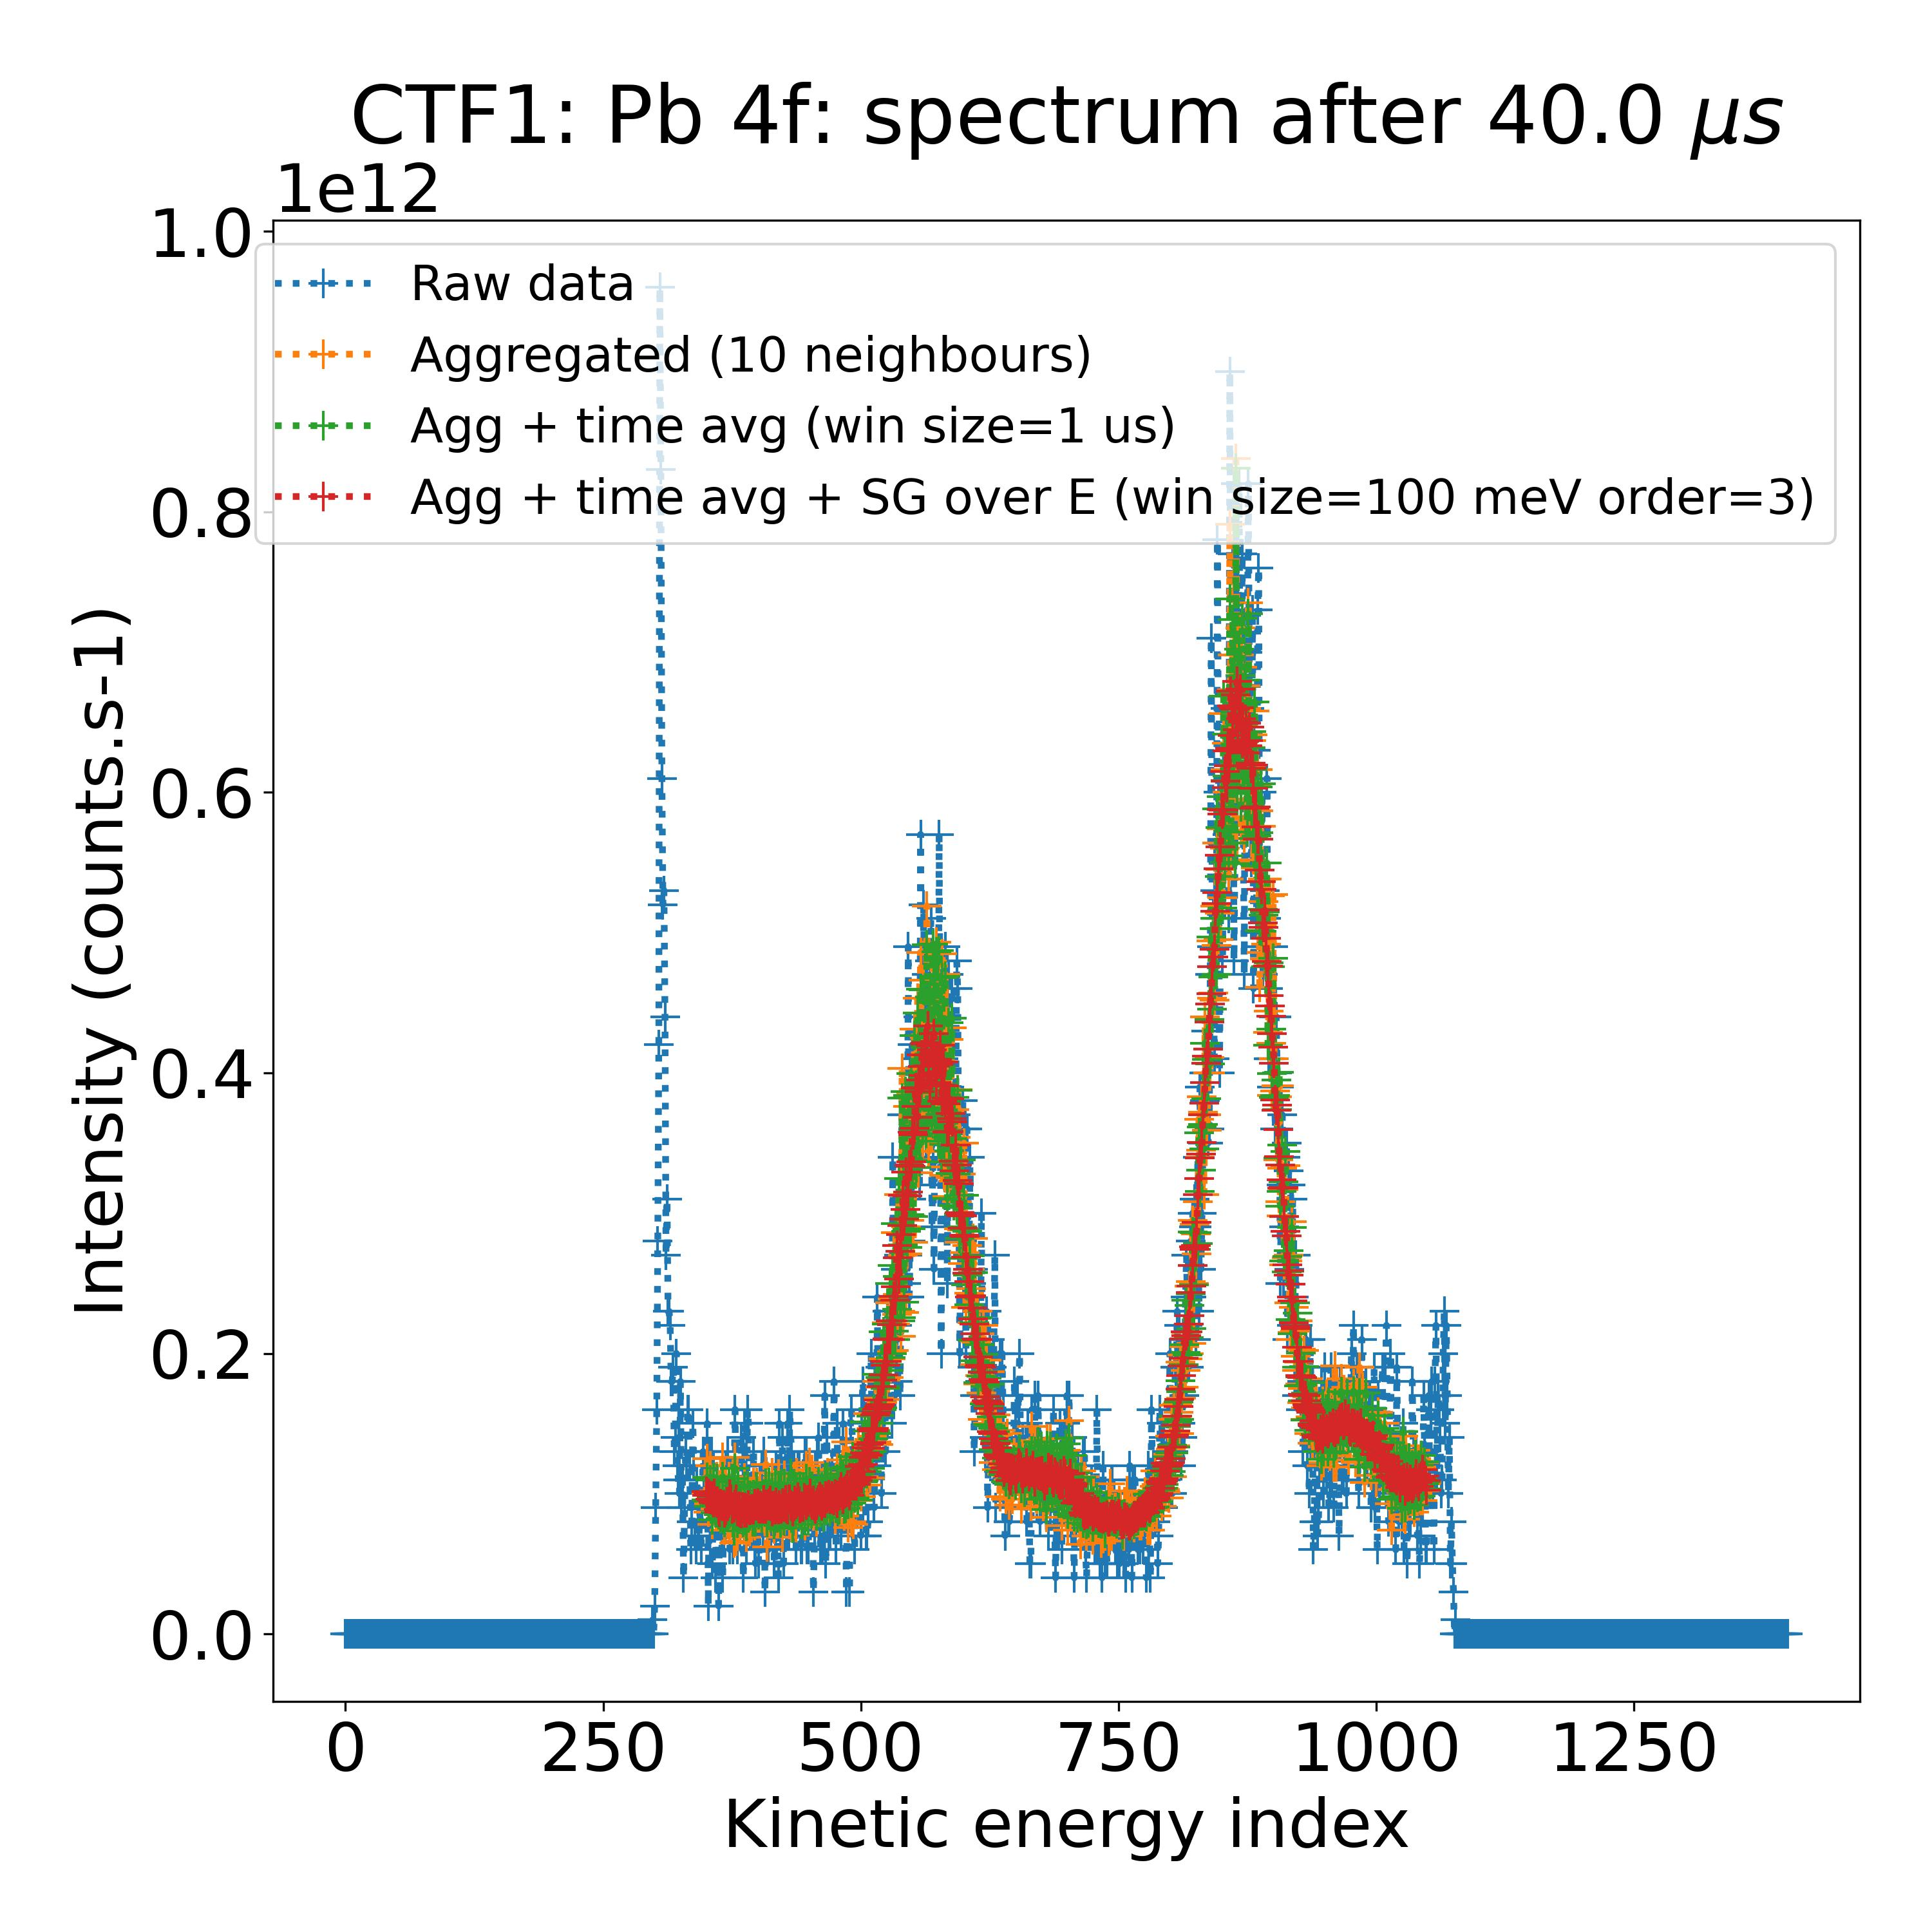
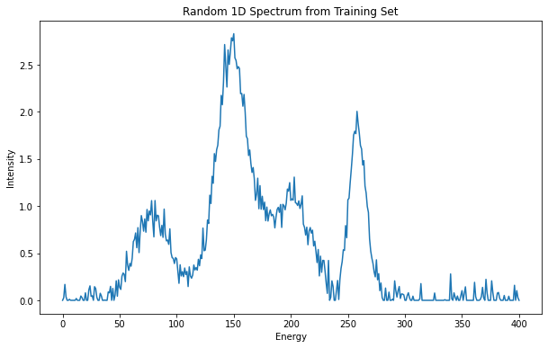
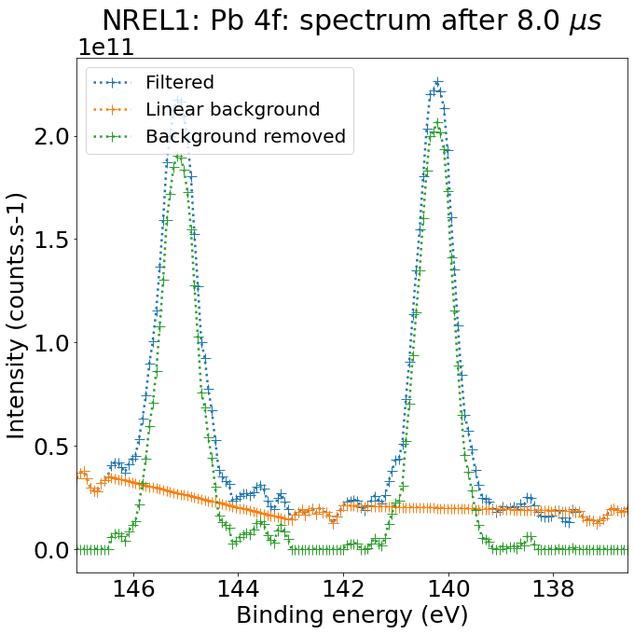

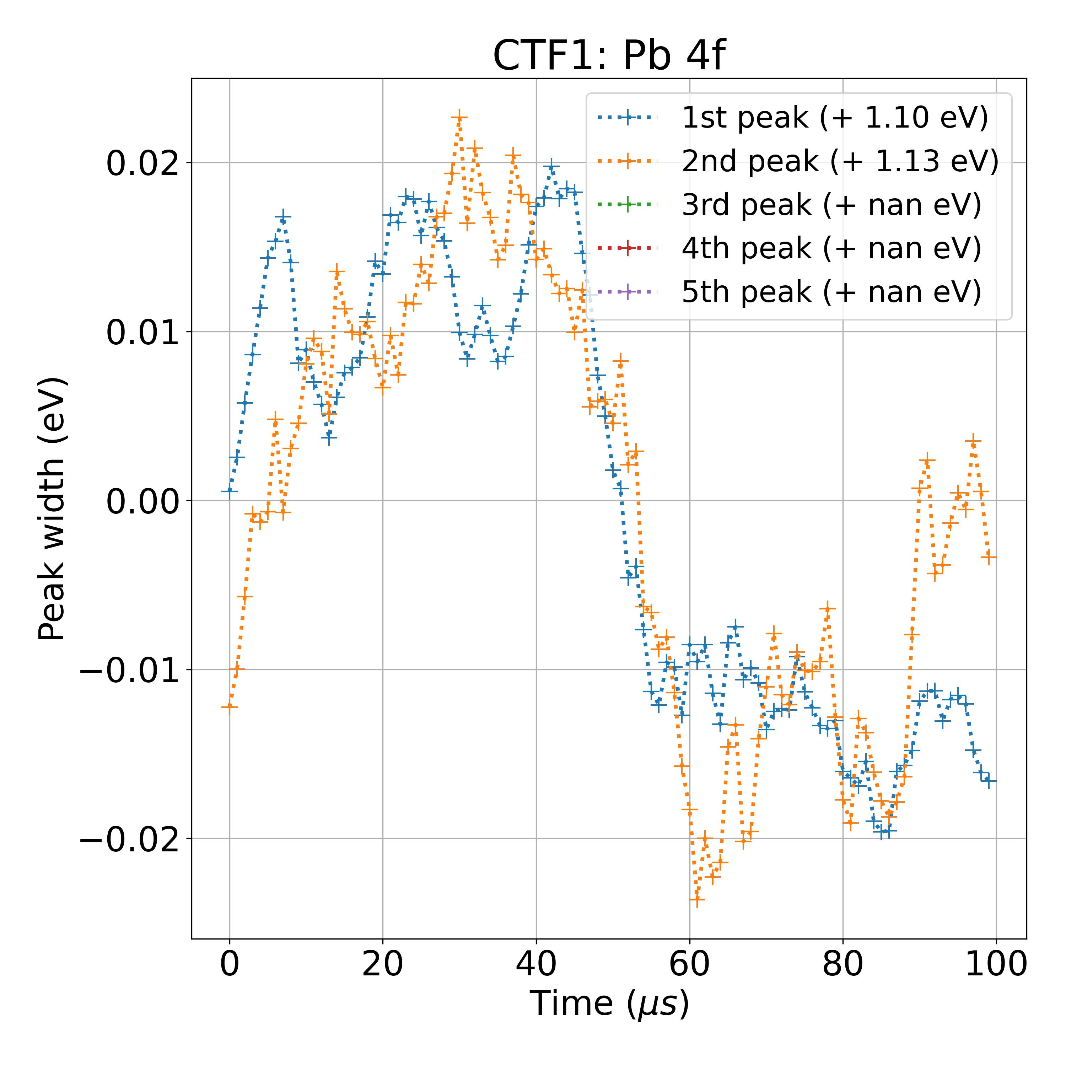
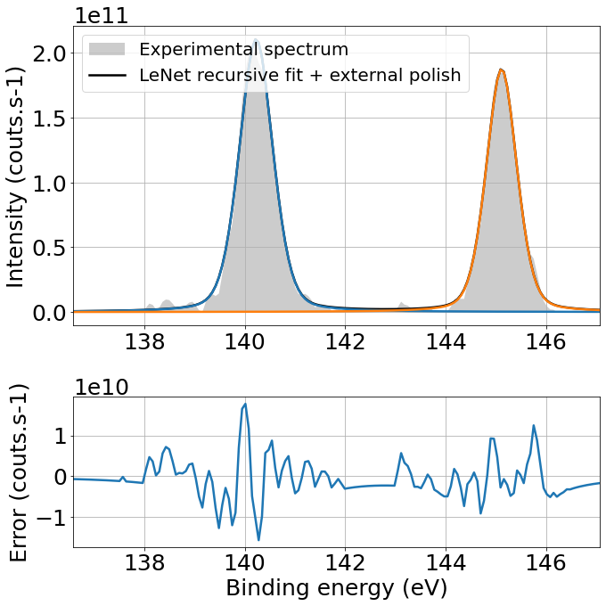
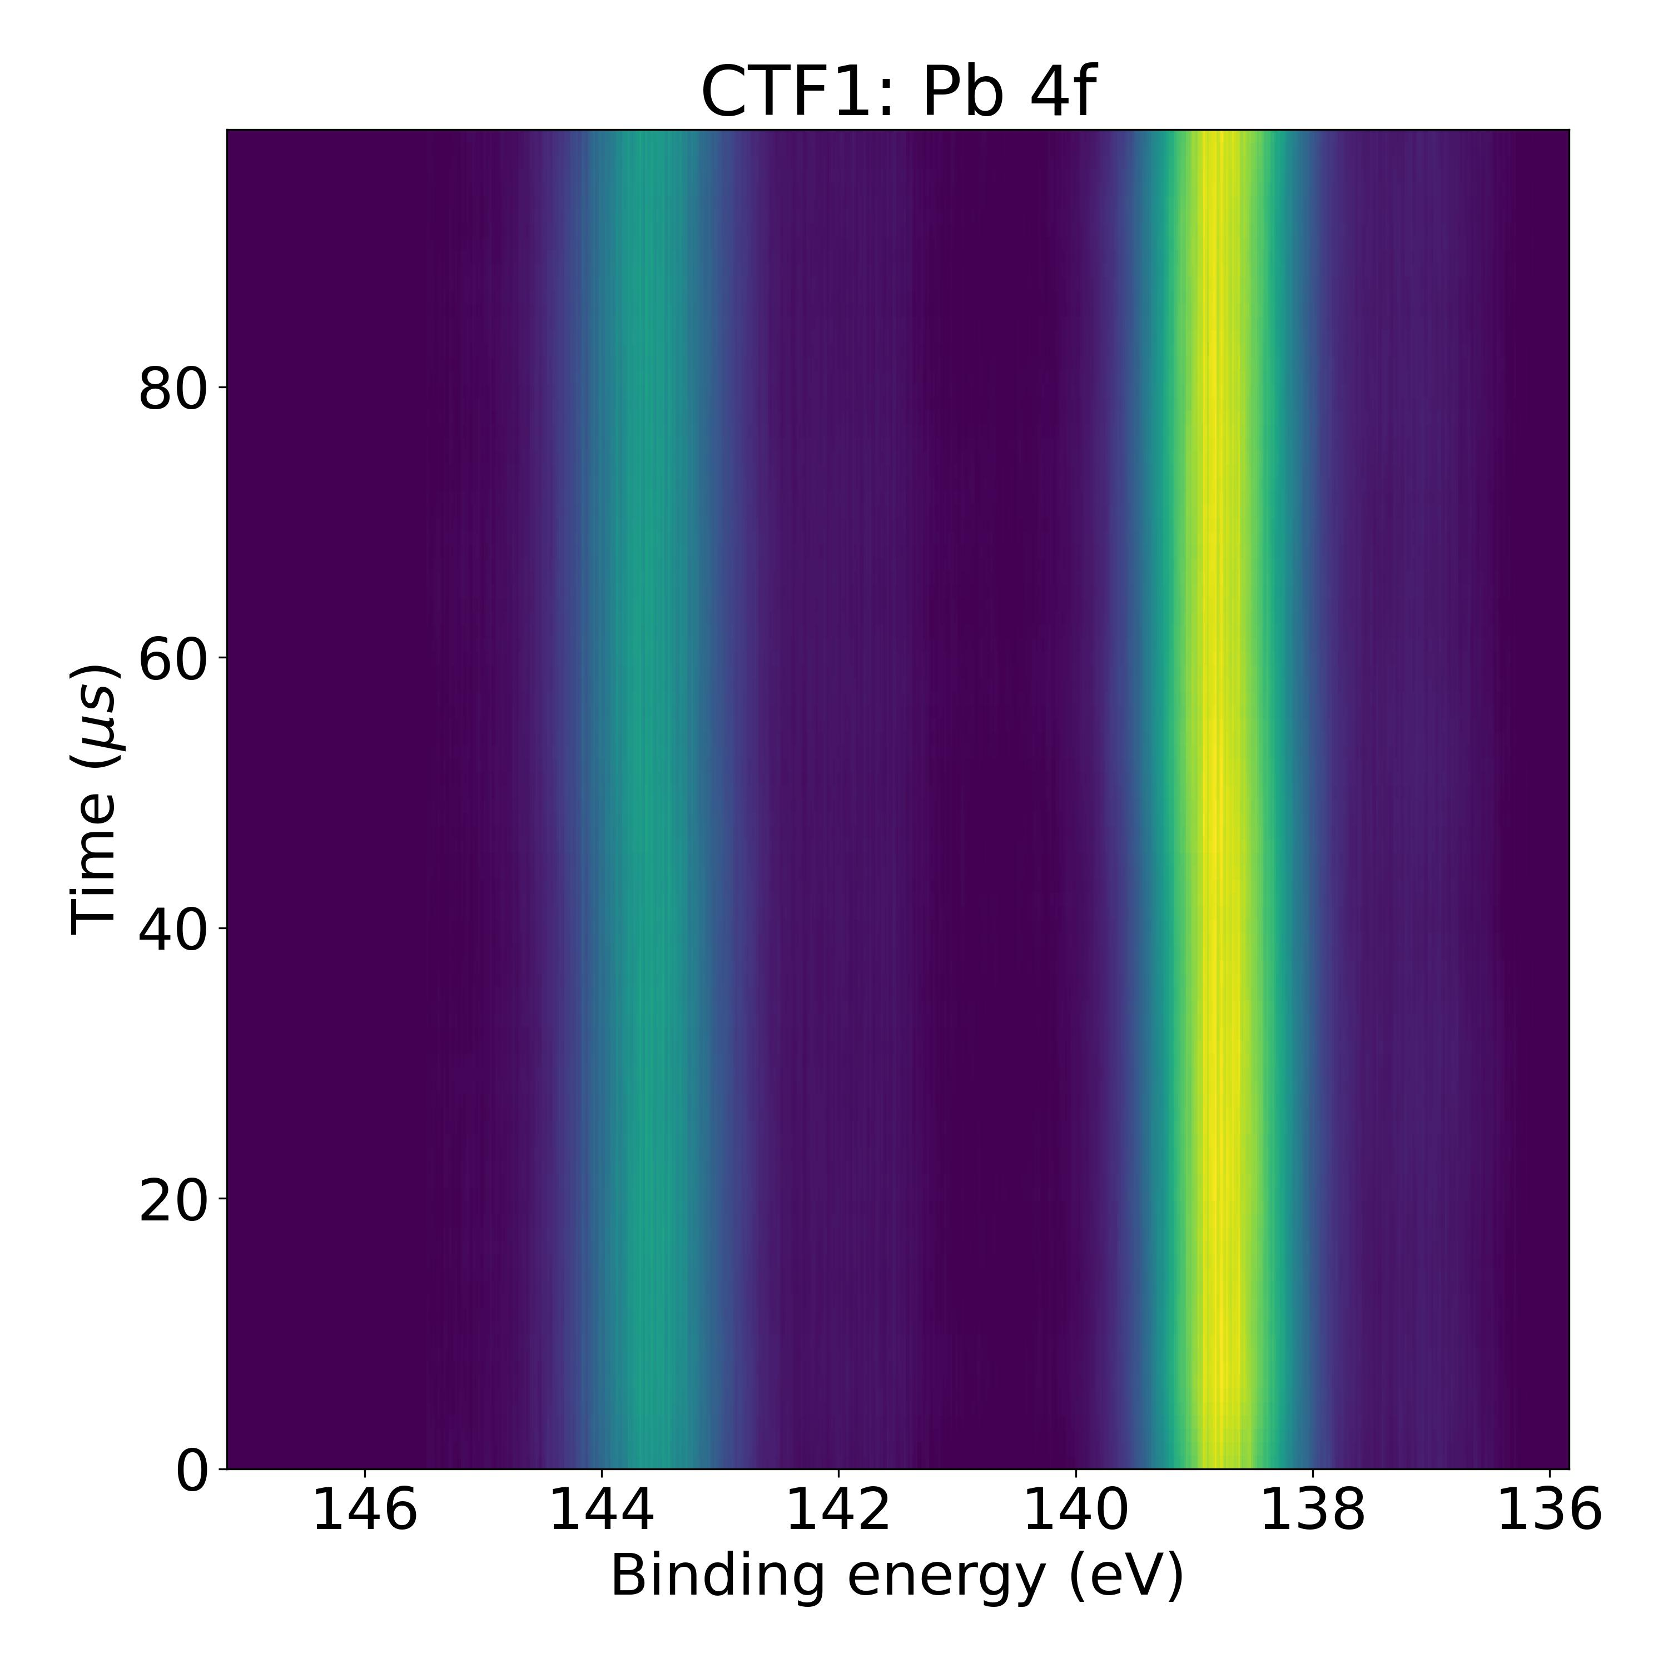
Processing of Experimental Spectra
STEPS
Input File Handling
Generation of 1D Spectra
Compilation of Spectra
Parameter Extraction from Metadata
Background Removal
Compilation of Background-Removed Spectra
Model Fitting with Optimization
Output of Peak Width Parameter

Slide 9
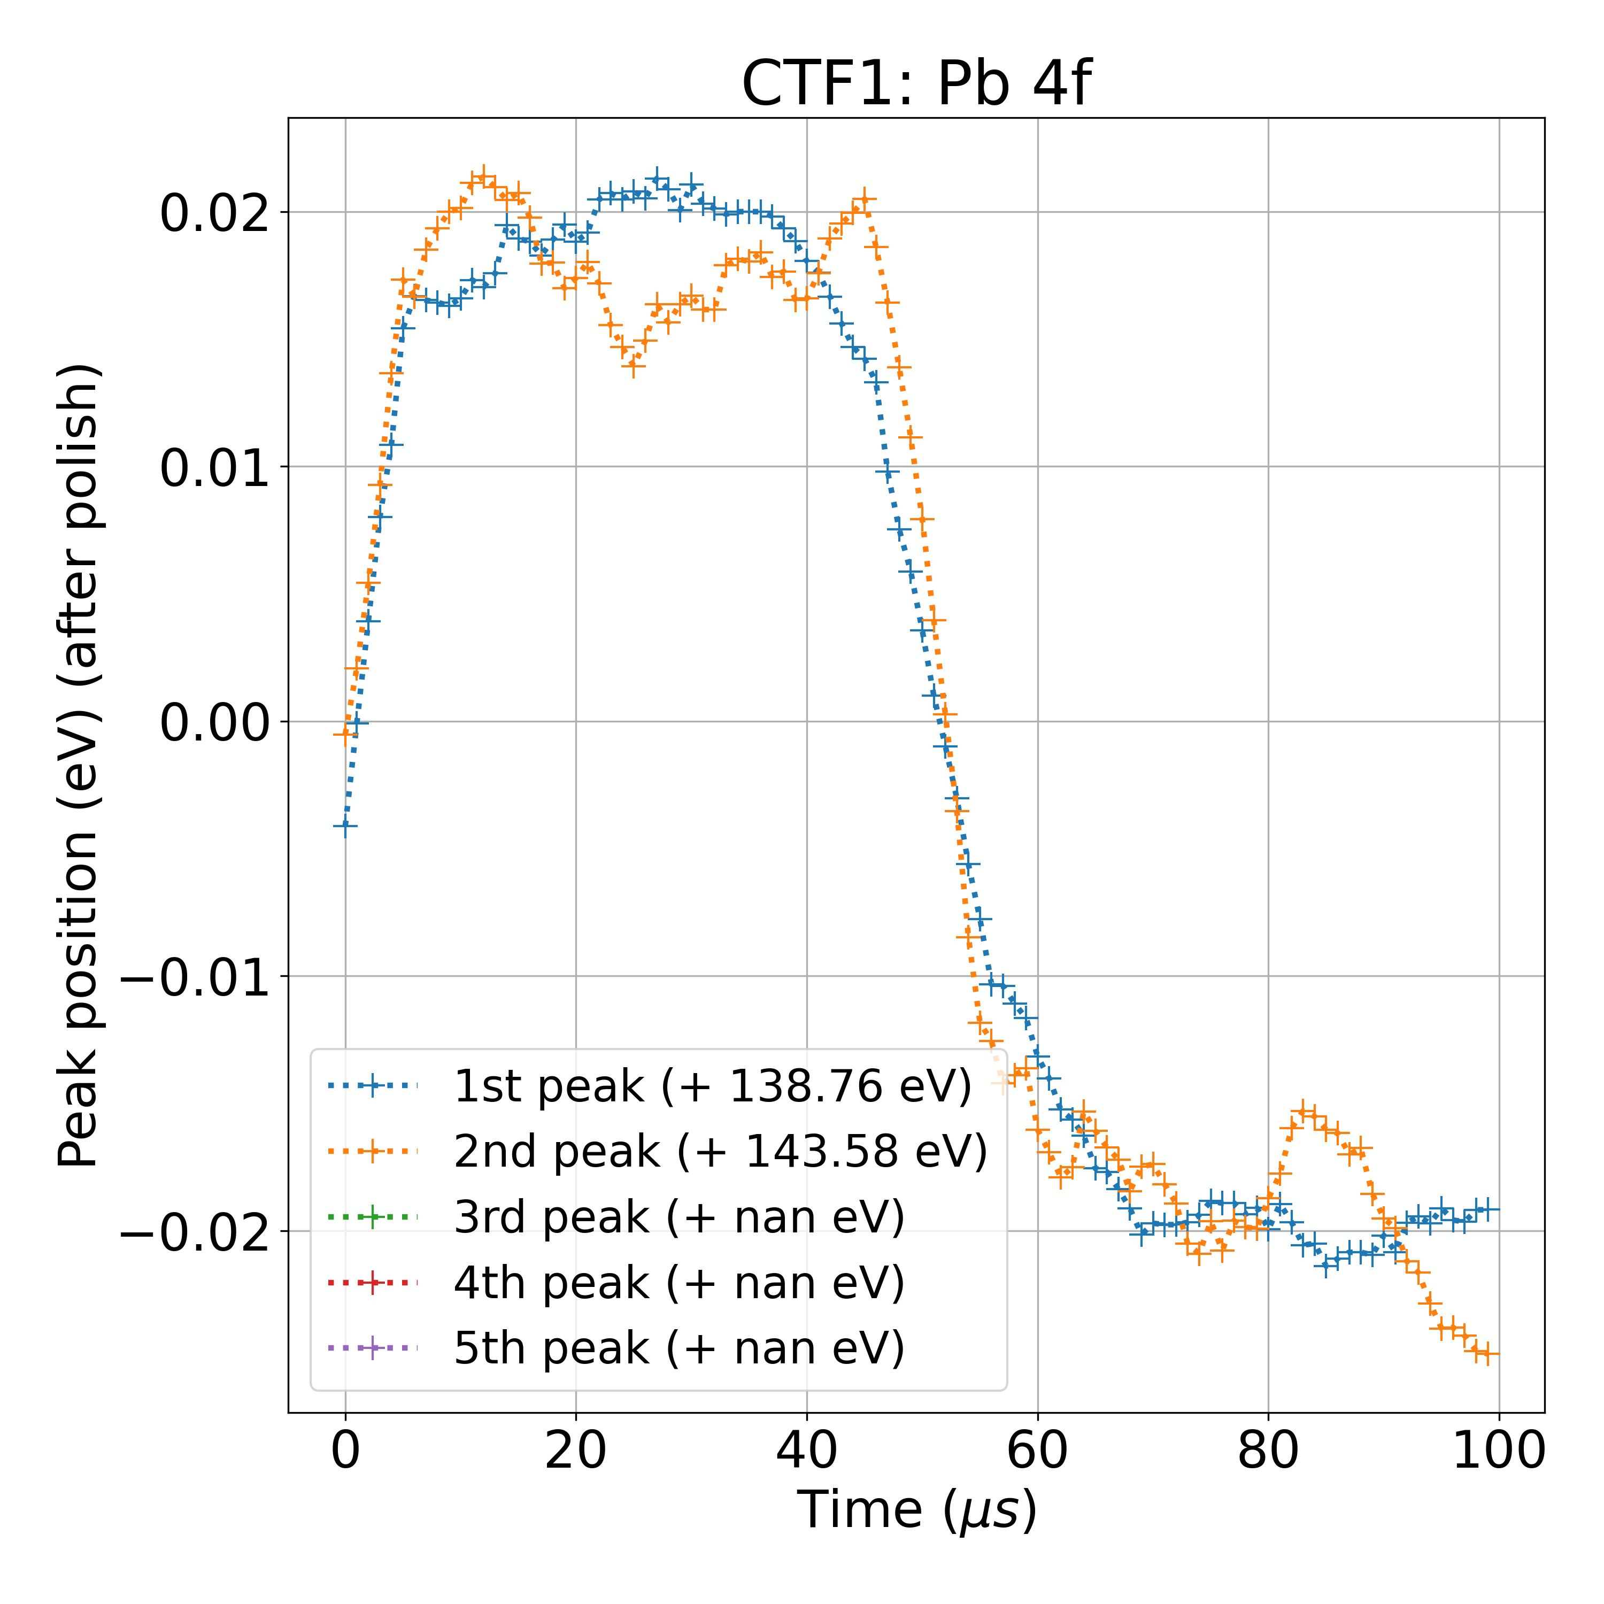
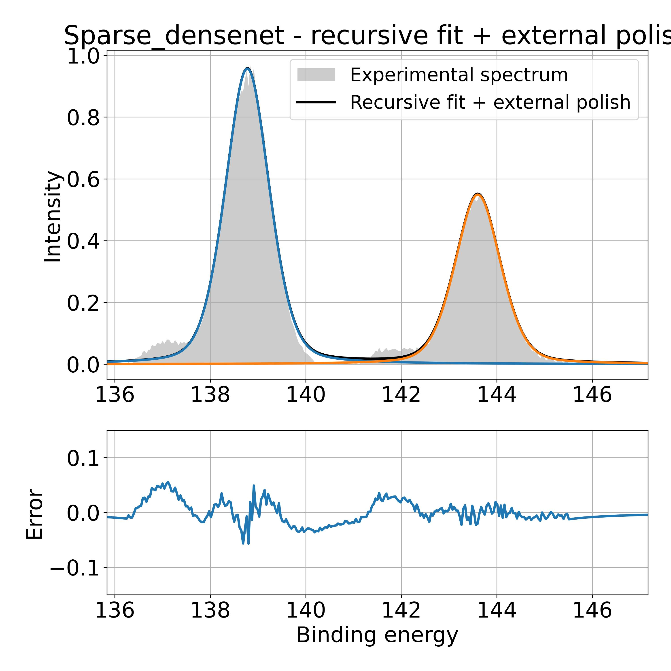
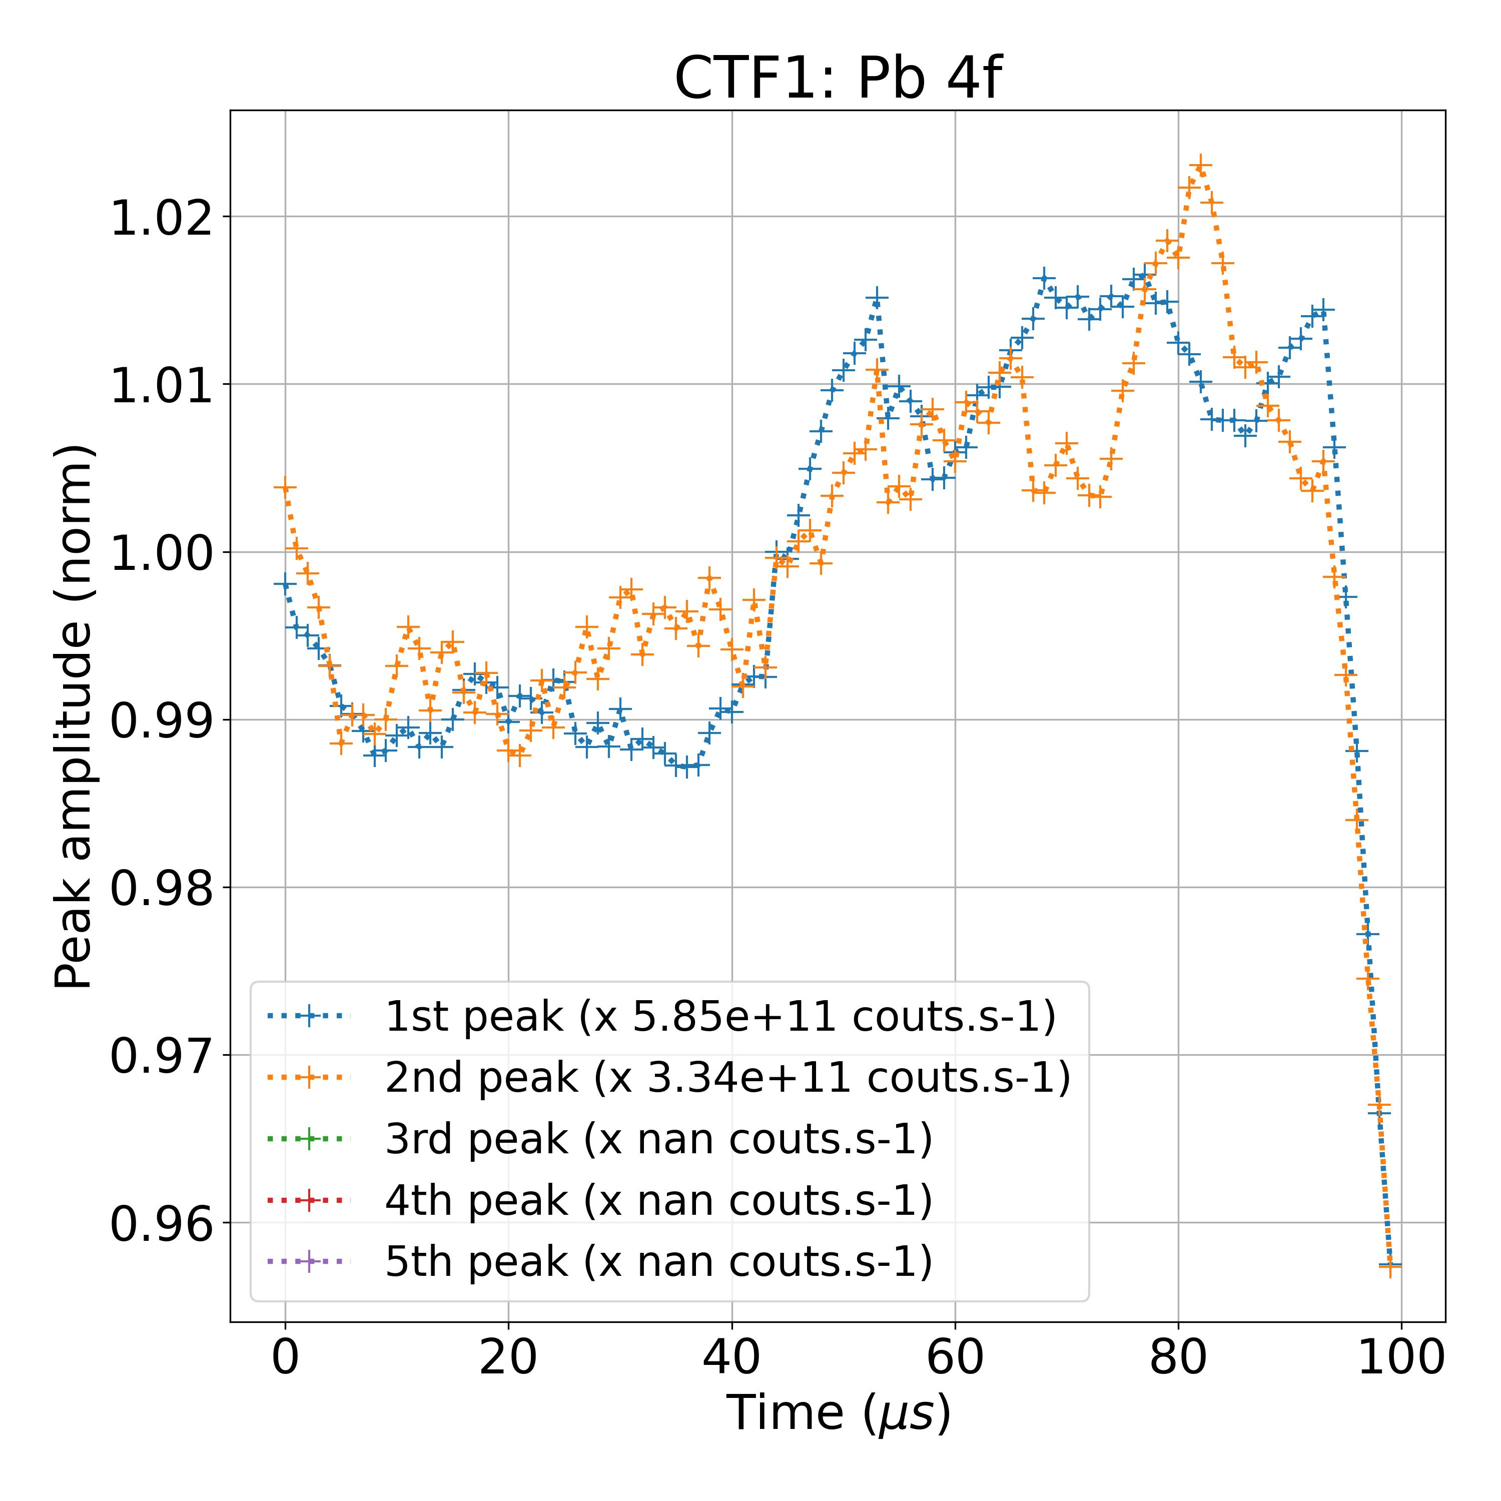
Results on Experimental TR-PES Measurements
4f 7/2
Total fit time (100 spectra): 43 sec
Laser off
Laser on
4f 5/2
(eV)
Filtering noisy experimental data

Slide 10
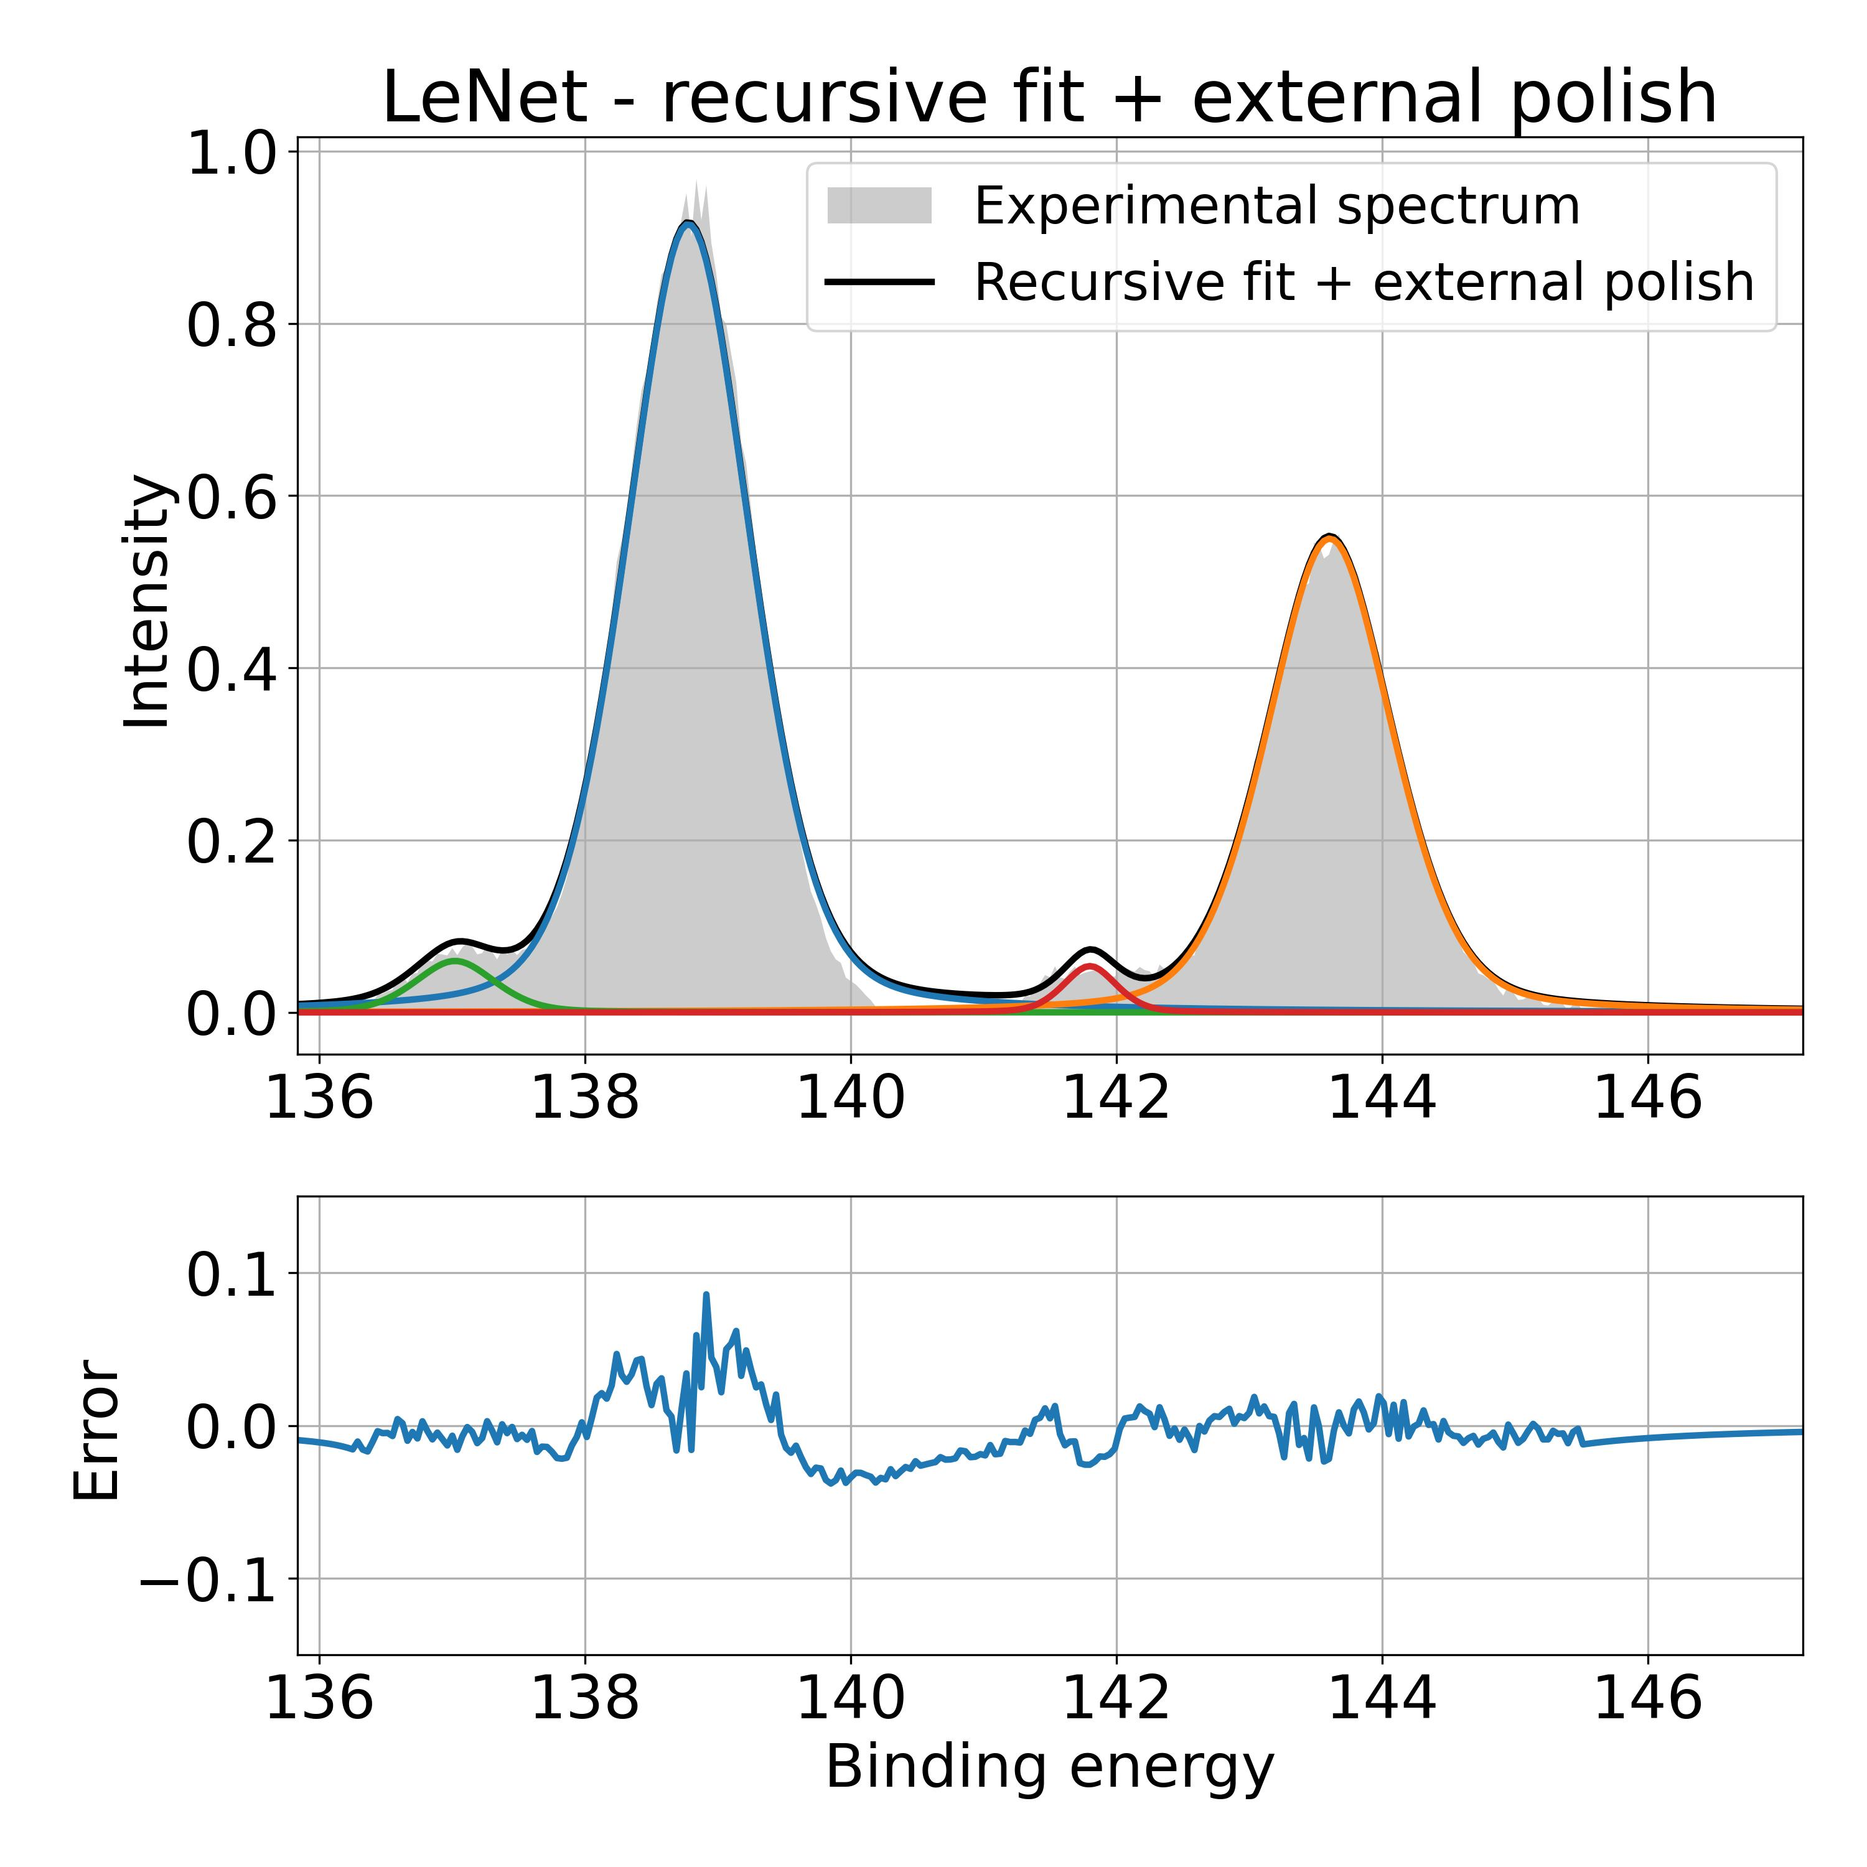
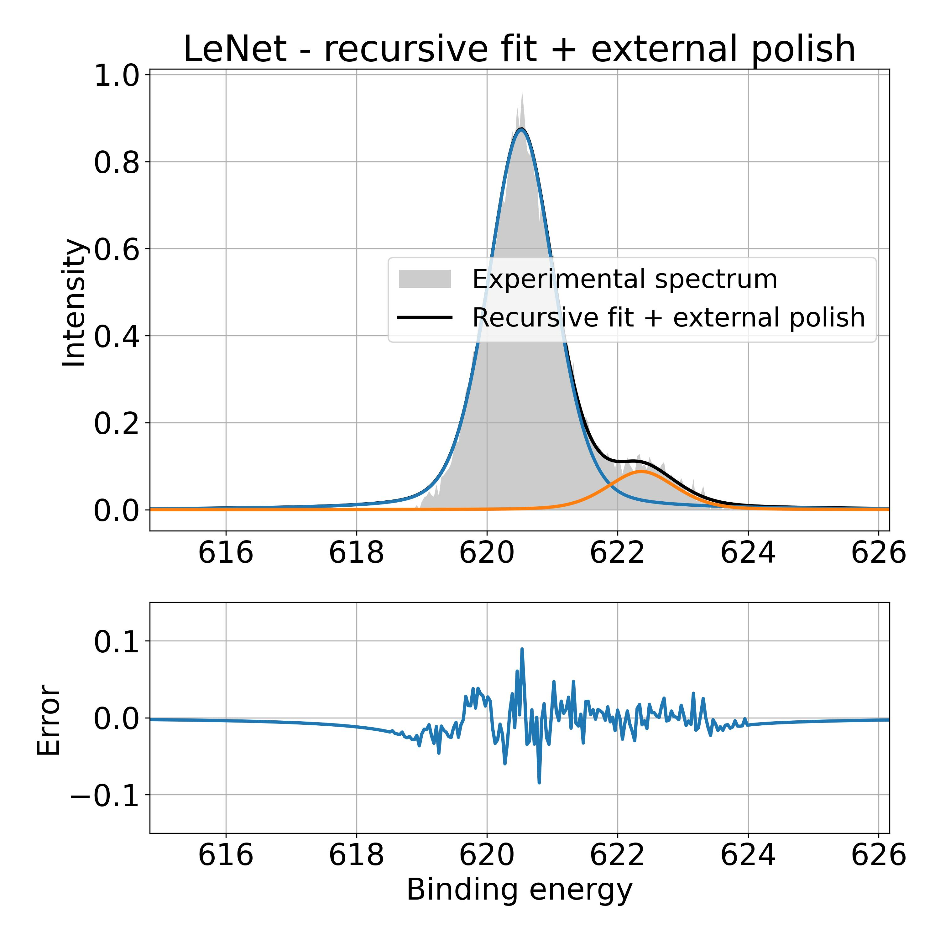
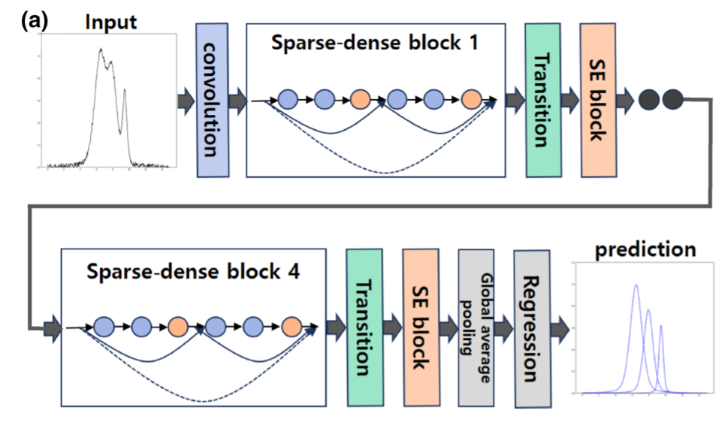
Perspectives
Possibility to track supplementary smaller contributions:
Bayesian Approach:
Pb 4f
I 3d 5/2
Adapt Bayesian attributes with powerful models like Sparse Densenet
Exploring the optimization with Bayesian CNN
Parzen Tree Estimator for Hyper parameters Opimization
Reducing the Effect of Noise in the experimental data
(eV)
(eV)
Adapt models and training to specific peaks identifications
Directly detect several peaks (vs iterative approach)
Detect pairs of 5/2 – 7/2 peaks
Park, S. H., Park, H., Lee, H., & Kim, H. S. (2021). Iterative peak-fitting of frequency-domain data via deep convolution neural networks. Journal of the Korean Physical Society, 79(12), 1199–1208.

Slide 11
steps
In Bayesian modelling, there are two main types of uncertainty one can model [9]: Aleatoric uncertainty and Epistemic uncertainty. Aleatoric Uncertainity – measures the noise inherent in the observations – Present in data collection ; sensor noise etc which is uniform along the dataset.
Epistemic uncertainty, on the other hand, represents the uncertainty caused by the model.

Slide 12
steps
Database | Size of total database: 191723 (10% of Relevant Dataset) Size of training database: 153378 Size of validation database: 19172 Size of test database: 19173
Training Duration | Bayesian CNN Training time for 50 epochs: 98201 s (27 hrs 16 min 41 sec) Bayesian_sparse_densenet Training time for 50 epochs: 95473 s (26 hrs 31 min 13 sec) Sparse_DenseNet Training time for 50 epochs: 202862 s (56 hrs 21 min 2 sec)

Slide 13
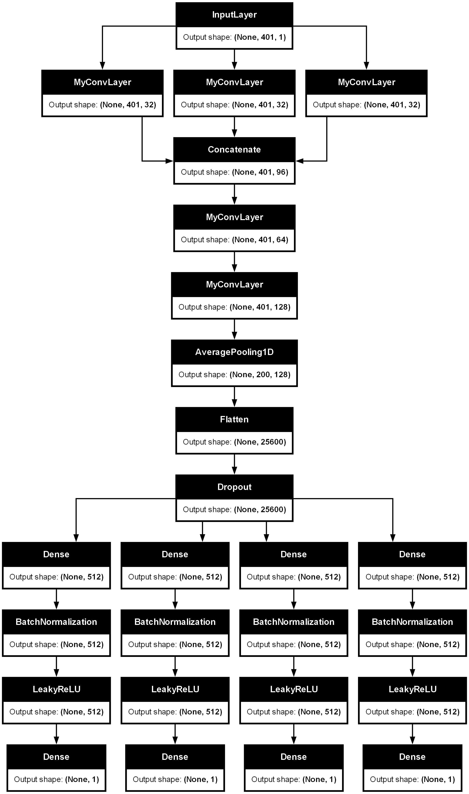
Architectures
Bayesian CNN
Bayes Sparse DenseNet
Sparse DenseNet

Slide 14

Attributes Comparison
Bayesian CNN | Sparse Dense net | Bayes Sparse Densenet
Proabilistic layers | Deterministic Layers | Probabilistic layers
Uses custom BayesianConv1D layer Also, wrapping ”tfp.layers.Convolution1DFlipout” | Standard - tf.keras.layers.Conv1D | Uses custom BayesianConv1D layer Also, wrapping ”tfp.layers.Convolution1DFlipout”
Key Differences
Bayesian layers, such as Convolution1DFlipout, use distributions for weights and biases instead of fixed values. These layers perform Bayesian inference, allowing the network to quantify uncertainty in its predictions.
The KL divergence term acts as a regularizer, encouraging the learned posterior distribution 𝑞 to stay close to the prior 𝑝. measures how one probability distribution diverges from a second, expected probability distribution results in prevent overfitting.
By making the KL divergence scale-invariant, the regularization effect remains consistent across different batch sizes and layer dimensions. This is crucial for training stability and ensuring that the regularization term is appropriately balanced with the data likelihood term in the loss function.
Shridhar, K., Laumann, F., & Liwicki, M. (2019, January 8). A Comprehensive guide to Bayesian Convolutional Neural Network with Variational Inference. arXiv.org. https://arxiv.org/abs/1901.02731

Slide 15
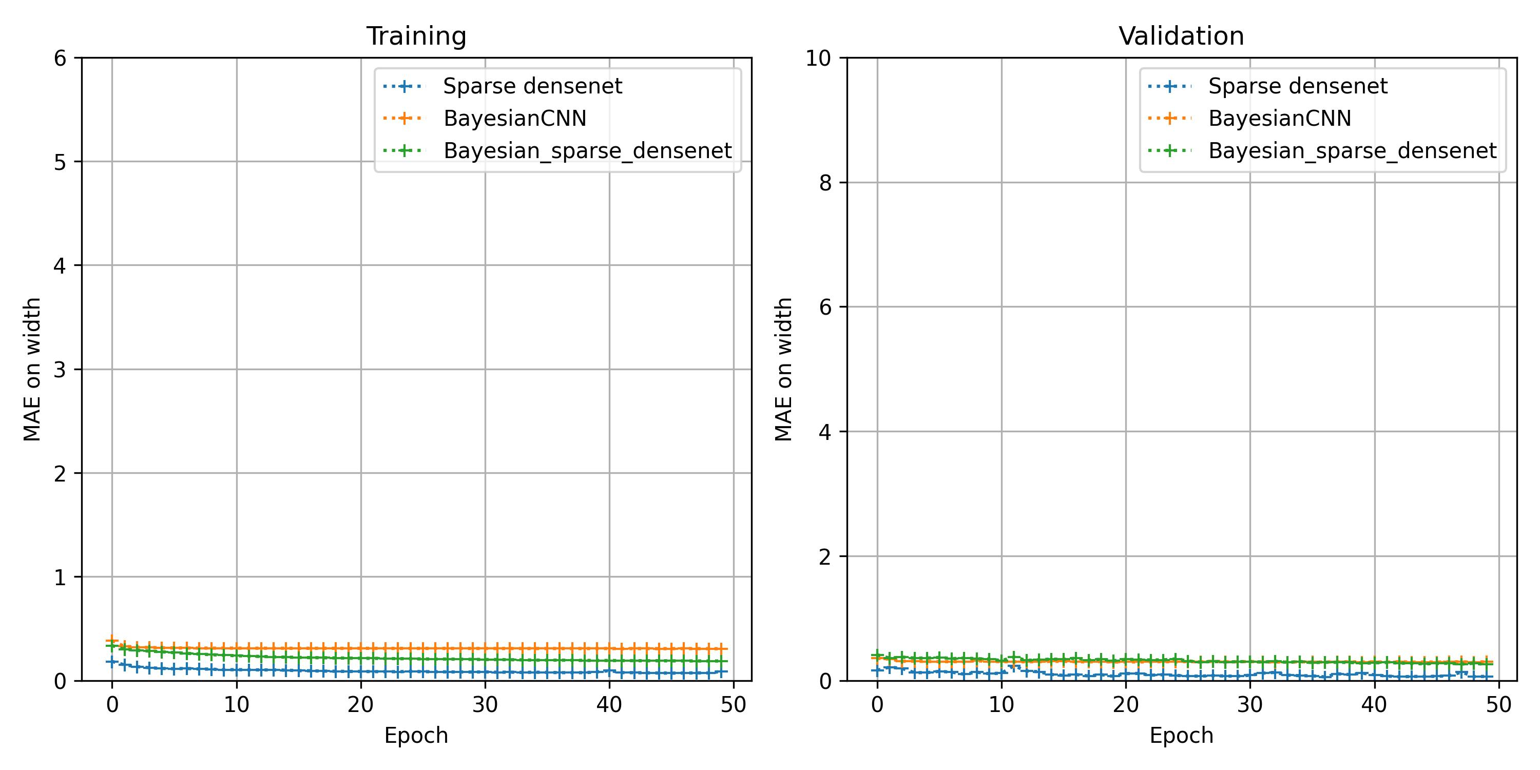
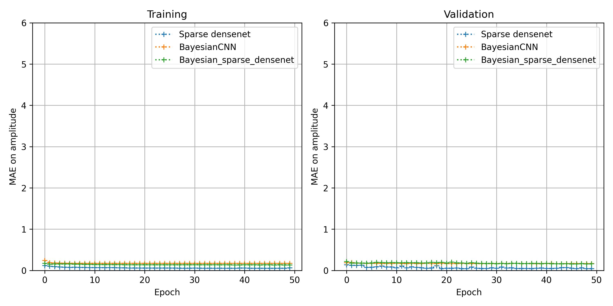
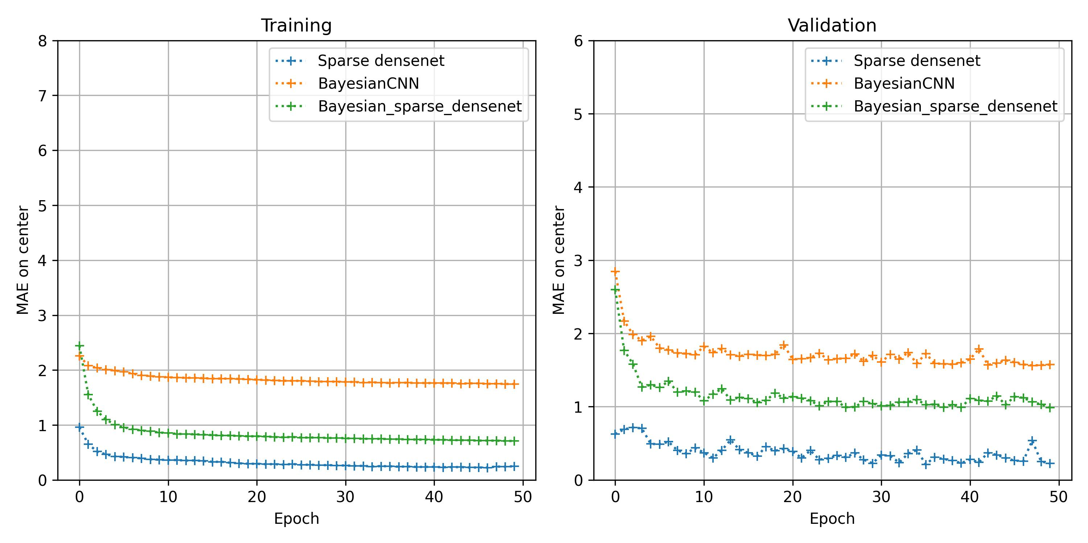
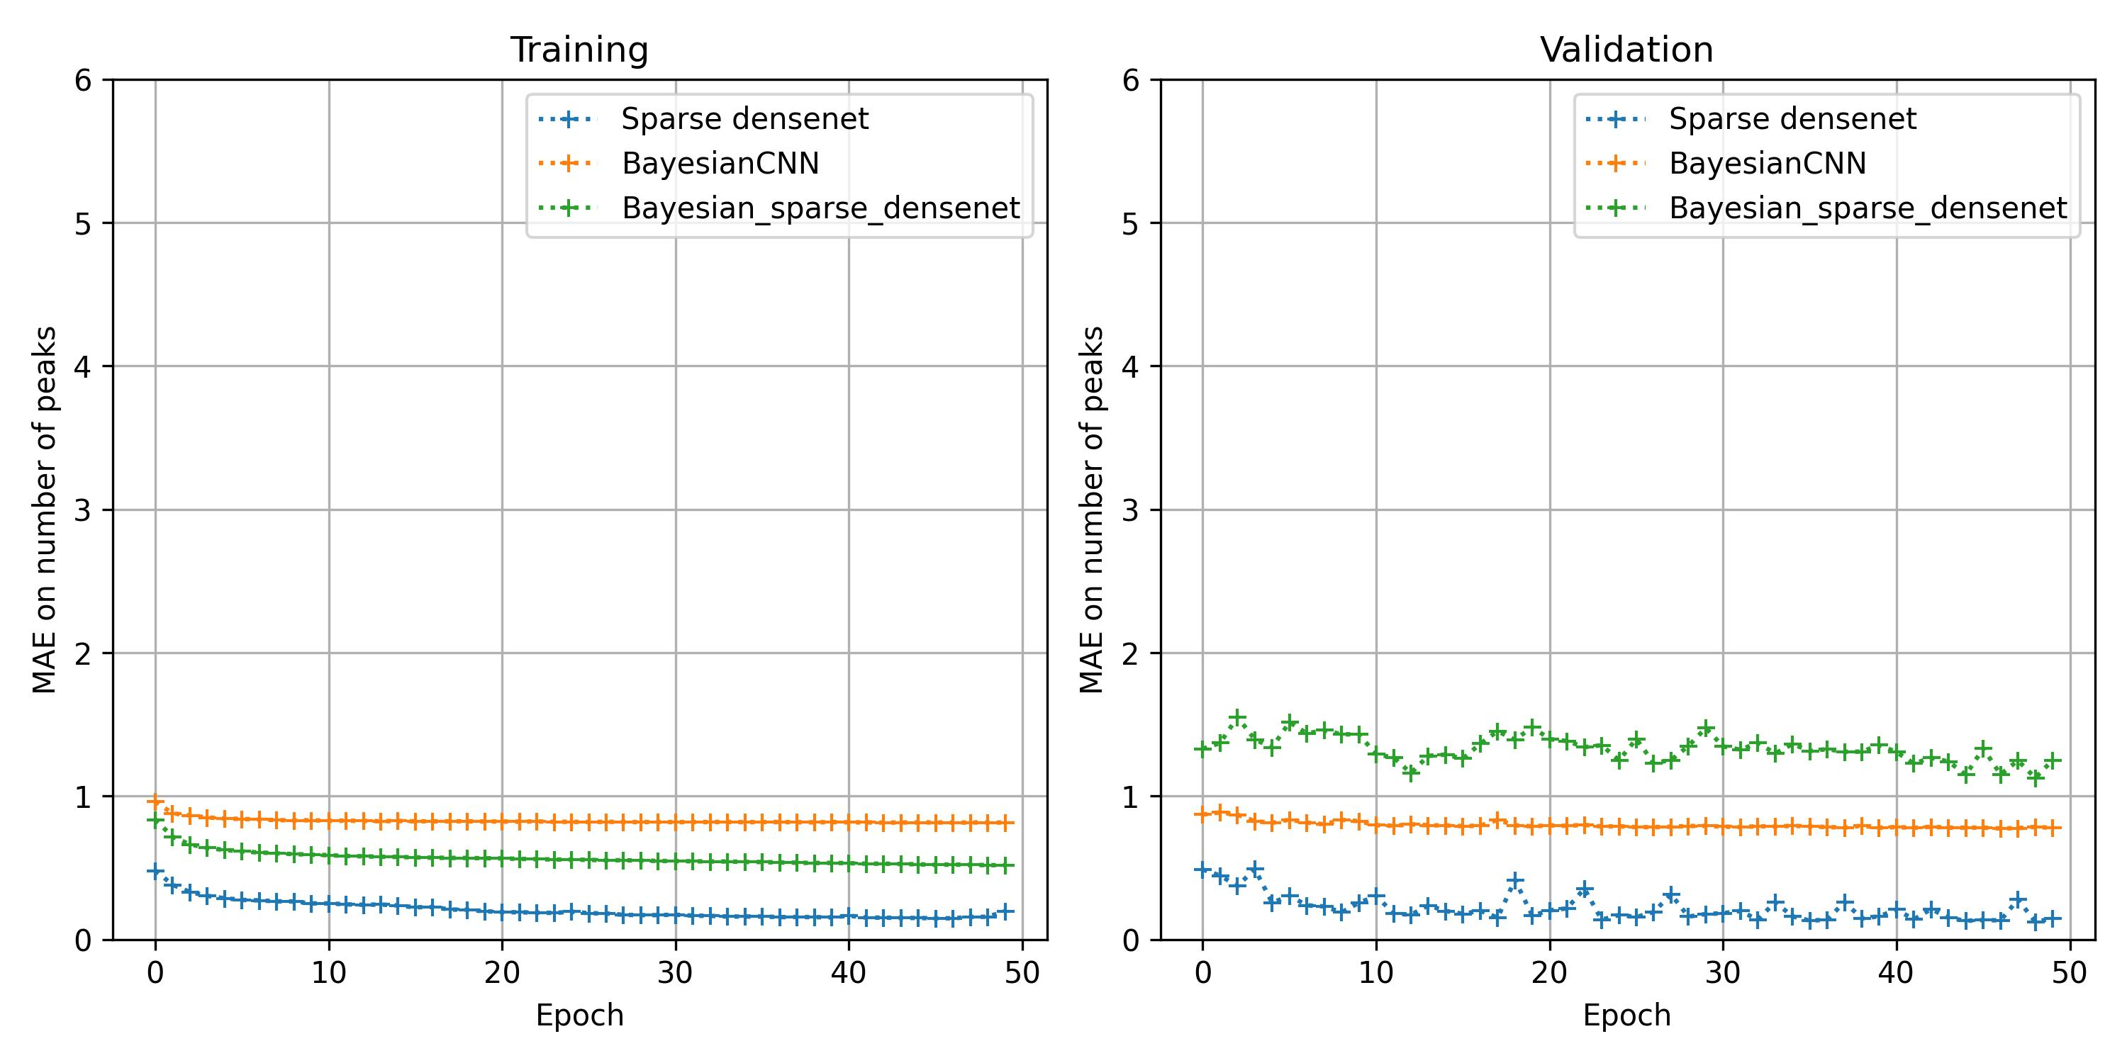
Training and Validation
MAE of Peak Position, Amplitude, Width and Number of Peaks

Slide 16
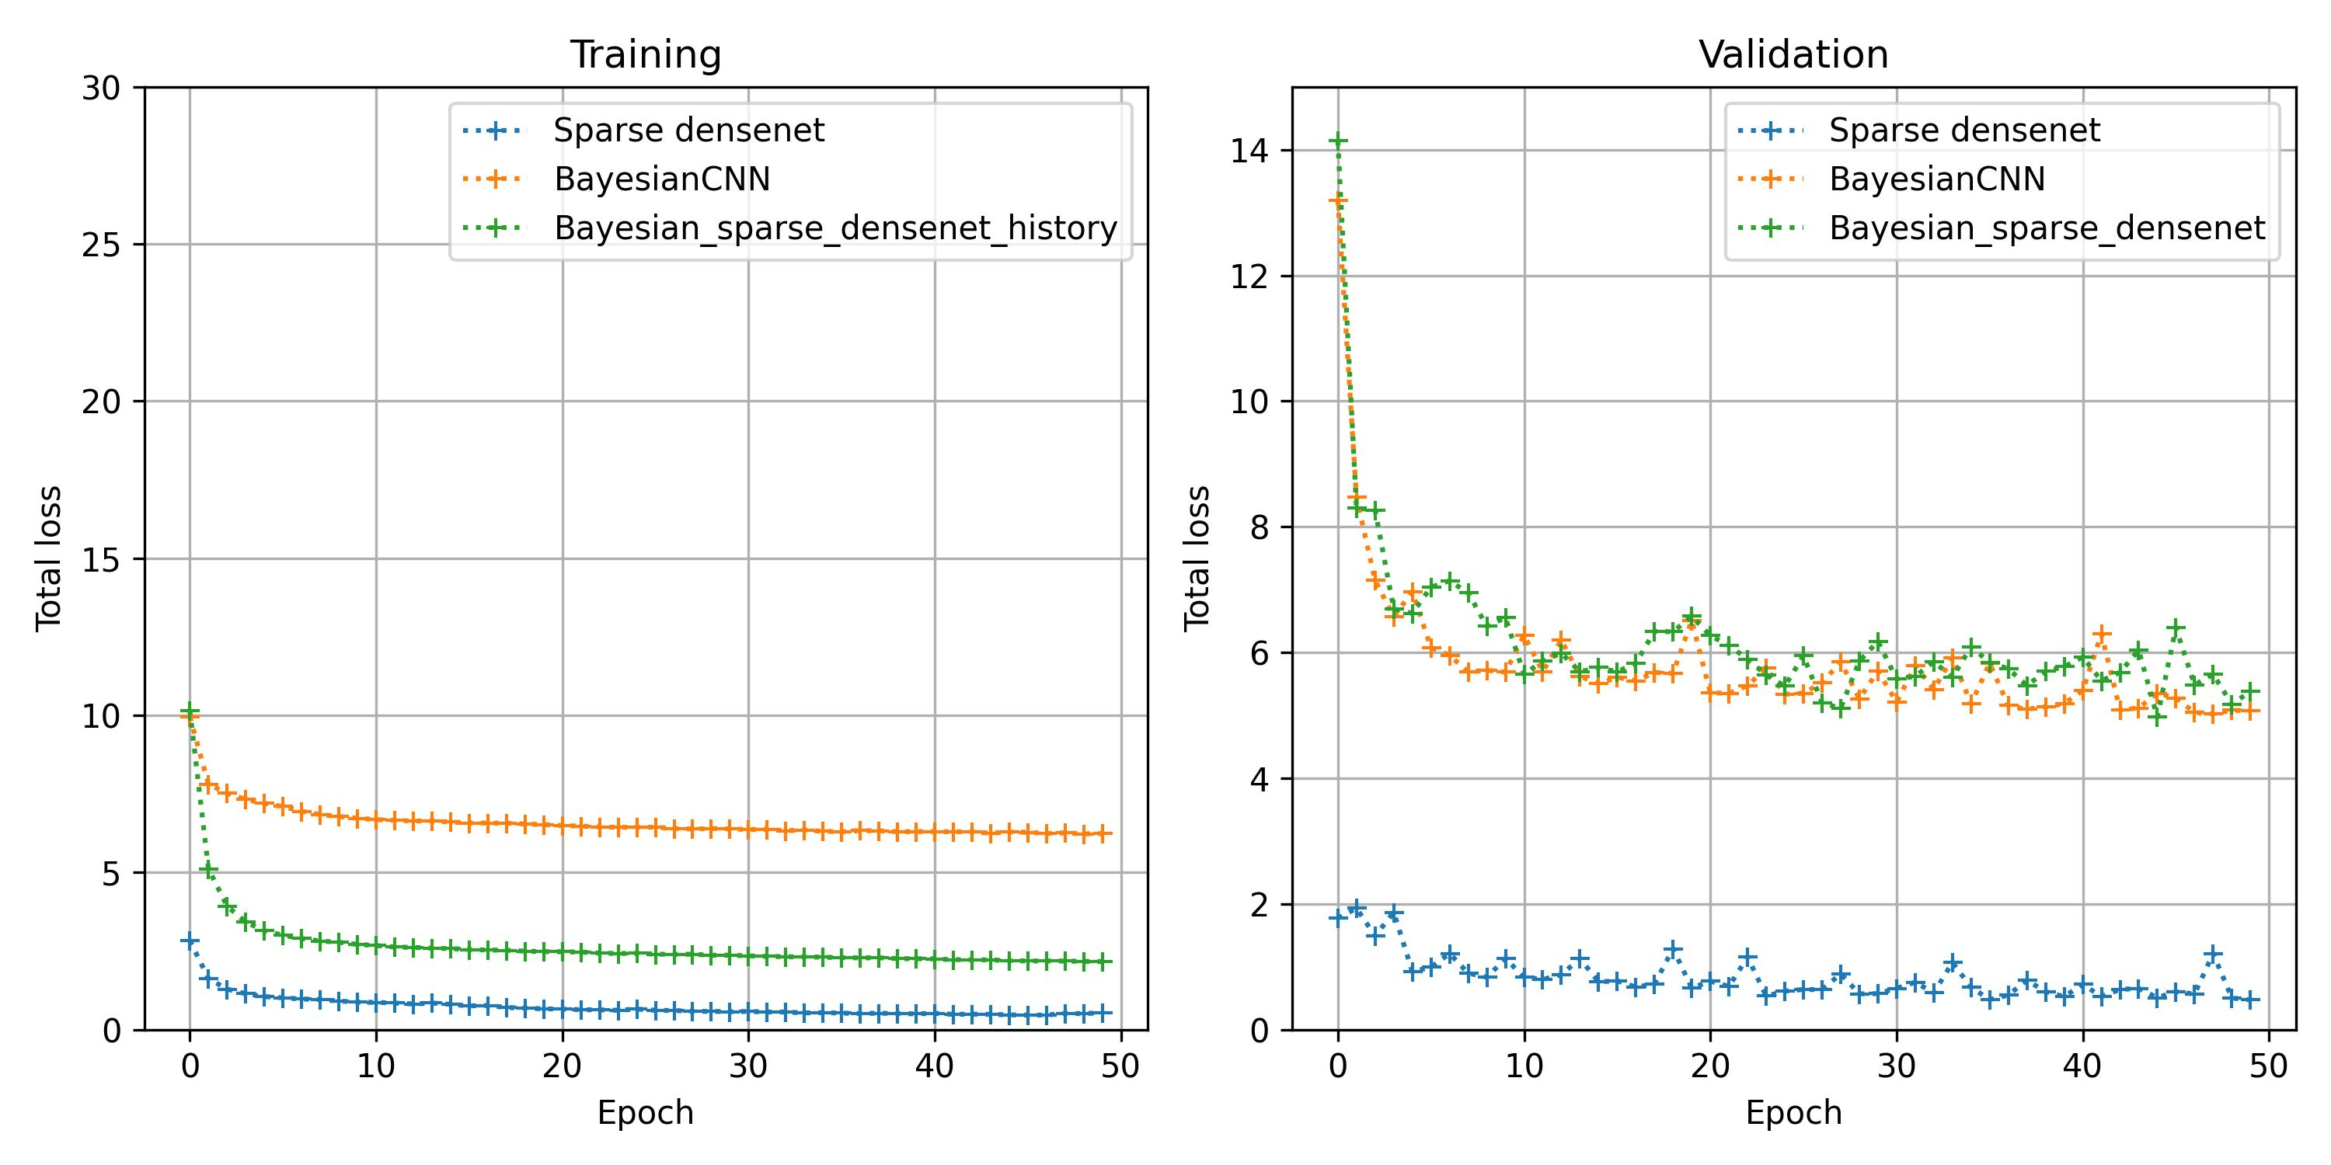
Total Loss
Testing and Recursive fit is on Process

Slide 17
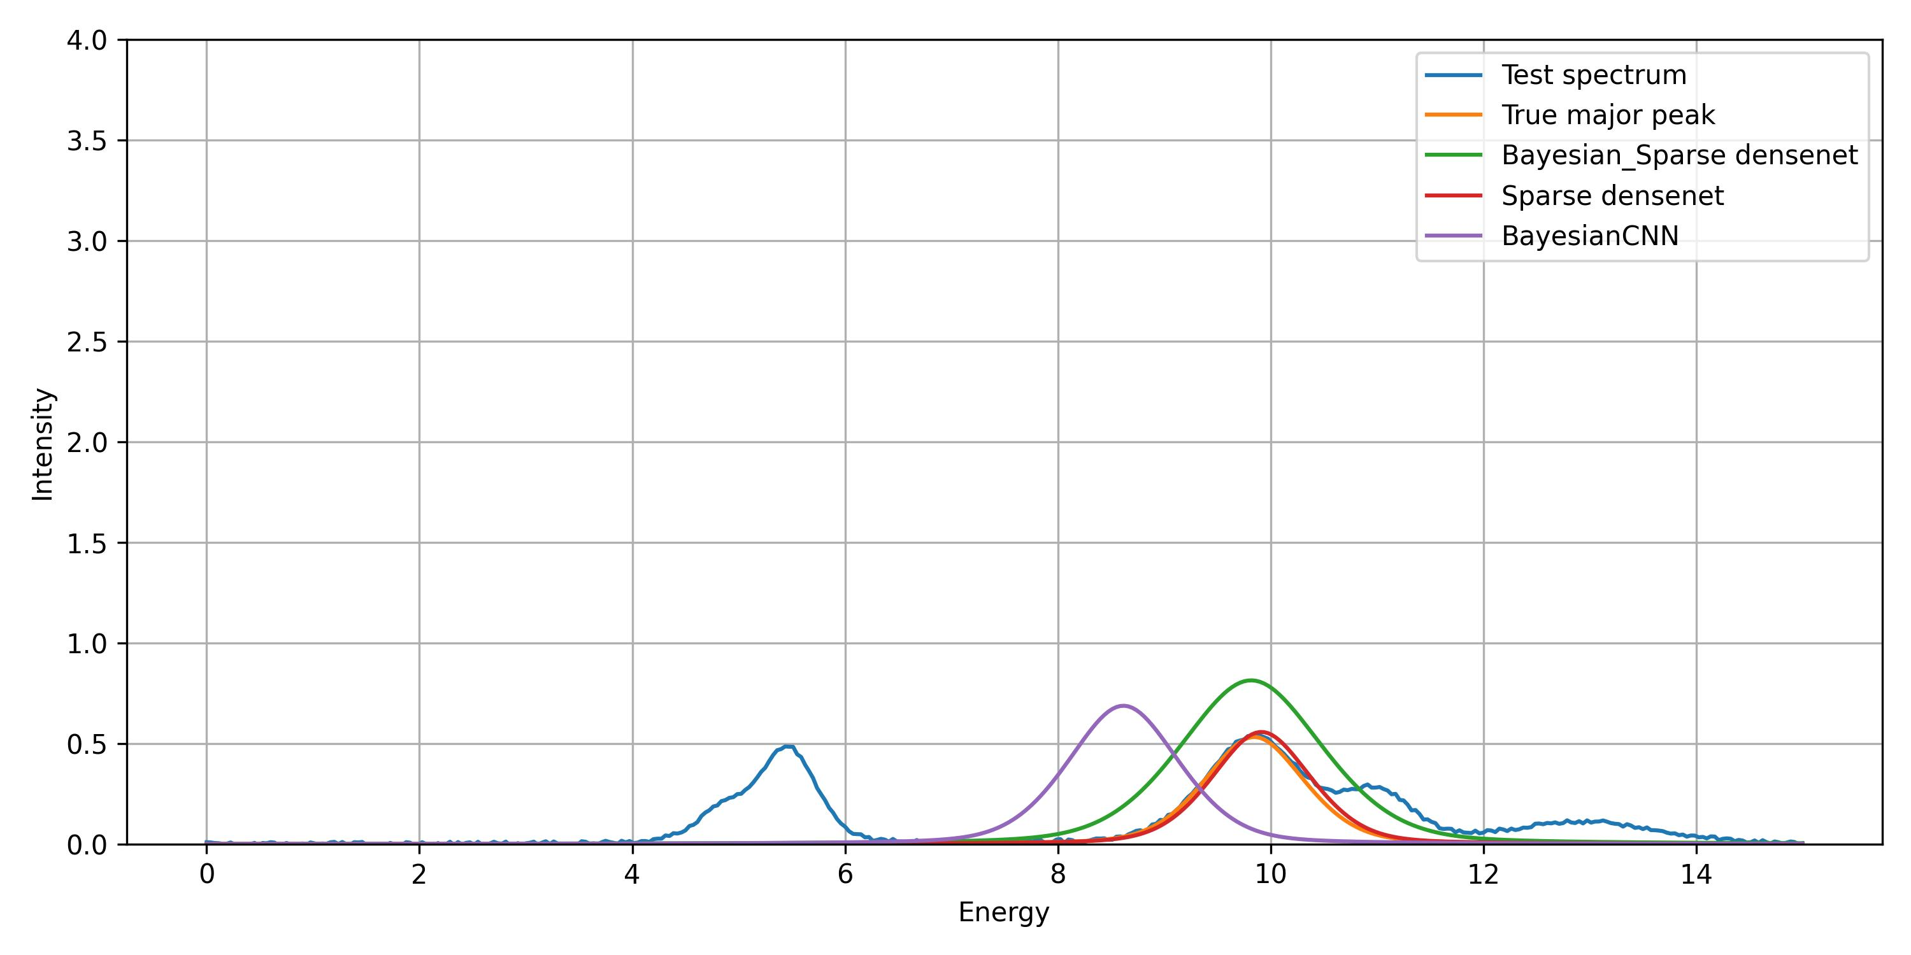
Test Results
Test | Bayes_Sparse_DNet | Bayesian_CNN | Sparse DenseNet
MAE on center | 1.01 | 1.01 | 0.23
MAE on width | 0.26 | 0.26 | 0.07
MAE on amplitude | 0.16 | 0.16 | 0.04
MAE on peak number | 1.26 | 1.24 | 0.15
Avg fit time per spectra | 0.0193 s | 0.00498 s | 0.0109 s

Slide 18
Tree Parzen Estimator
TPE is a sequential model-based optimization (SMBO) algorithm used for Hyperparameter optimization in machine learning.
Network Architecture:
Number of layers
Number of filters in each convolutional layer
Kernel sizes for convolutional layers
Strides for convolutional layers
Activation Functions:
Type of activation function (e.g., ReLU, LeakyReLU, softplus)
Alpha value for LeakyReLU
Regularization:
Dropout rates
L1/L2 regularization strengths
Optimization:
Learning rate
Batch size
Number of epochs

Slide 19
Total Loss
Perspectives
Background
Recursive Fit for all the networks
Overall Result comparison
Hyperparameter Optimisation
Assumption: Effect of Noise results in overfitting
One way fitting approach
Recursive Fit of Bayesian CNN vs Bayesian Sparse Densenet
Jean-Baptiste Inputs
Run the Model with a Noisy Database, as it had better fit
Philip Inputs
Prepare a thorough explanation in Bayesian approach in accordance with
Robust
Reliable
Faster

